Slide 1


Entrepreneur
connection
Small Business Program

Slide 2



The Entrepreneur Connection program provides education, resources, and access to capital to help entrepreneurs start or expand a business. ​
14

Slide 3
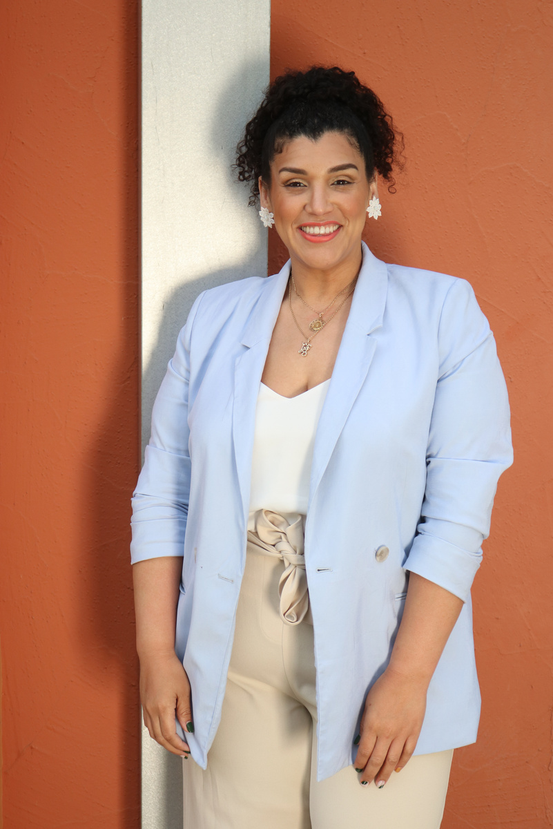
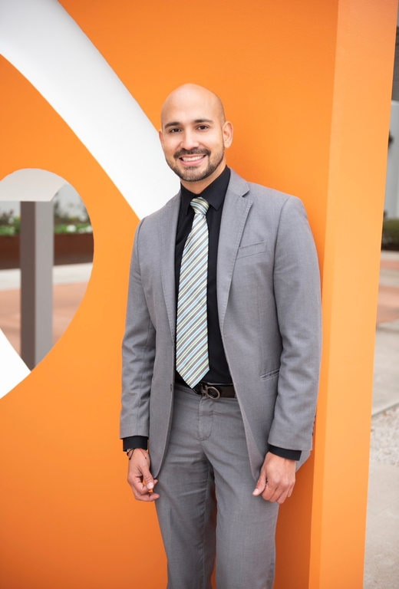
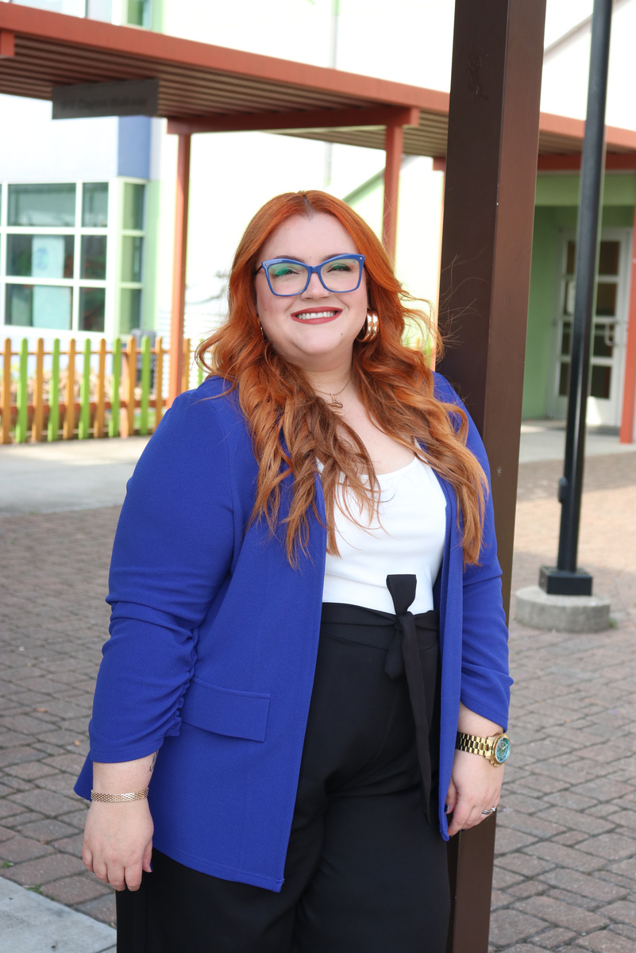
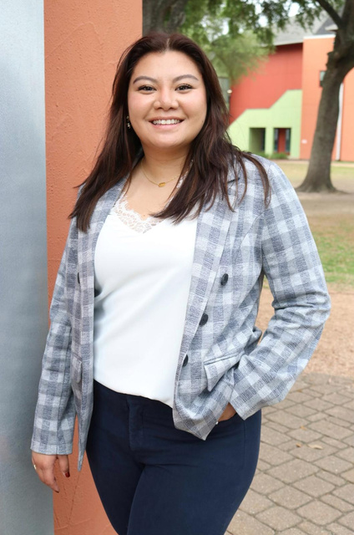


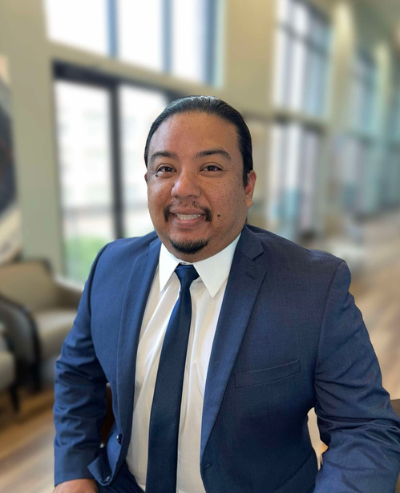
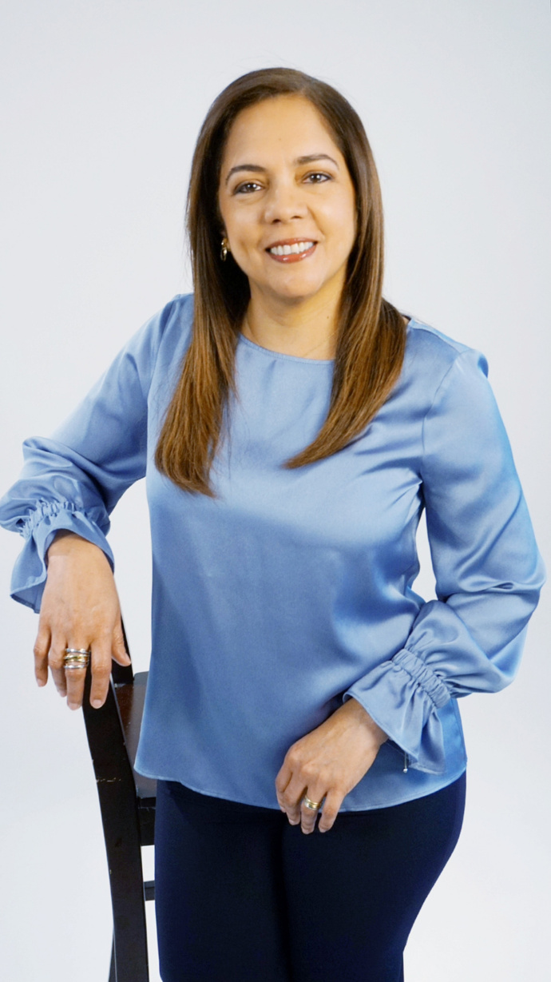
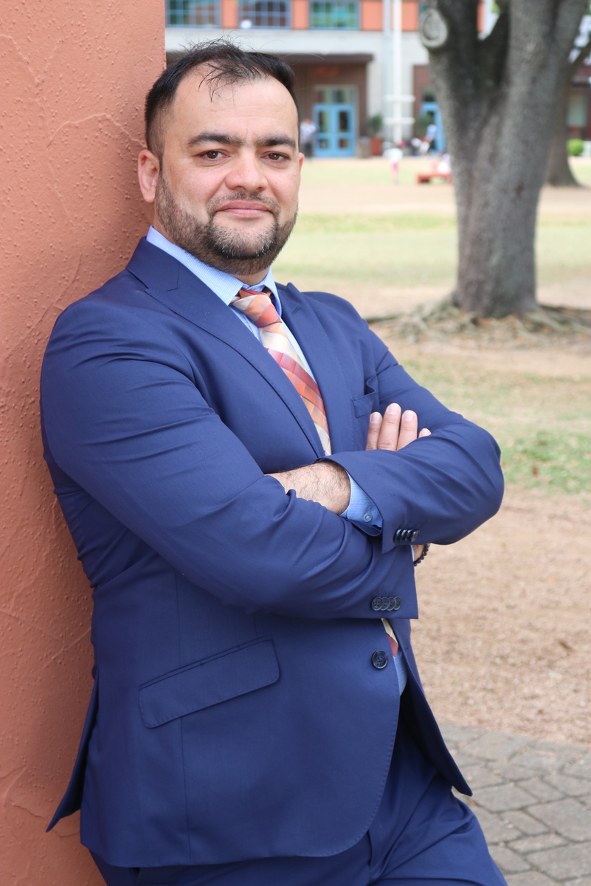
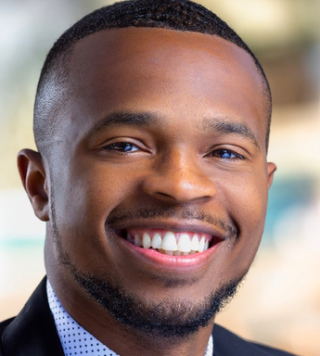
MEET THE TEAM
Nini Gutierrez
Director of
Small Business Program
Alexis Rios
Small Business Coaching Manager
Dany Vierra
Small Business Education Manager
Andrea Lock
Small Business Education Coordinator
Carlos Chen
Small Business Coach-Pasadena
Karla Murillo
Small Business
Coach-East Aldine
Sadiq Sameer
Small Business Coach-Gulfton
Sebastian sanders
Small Business Coach-Ripley House

Slide 4

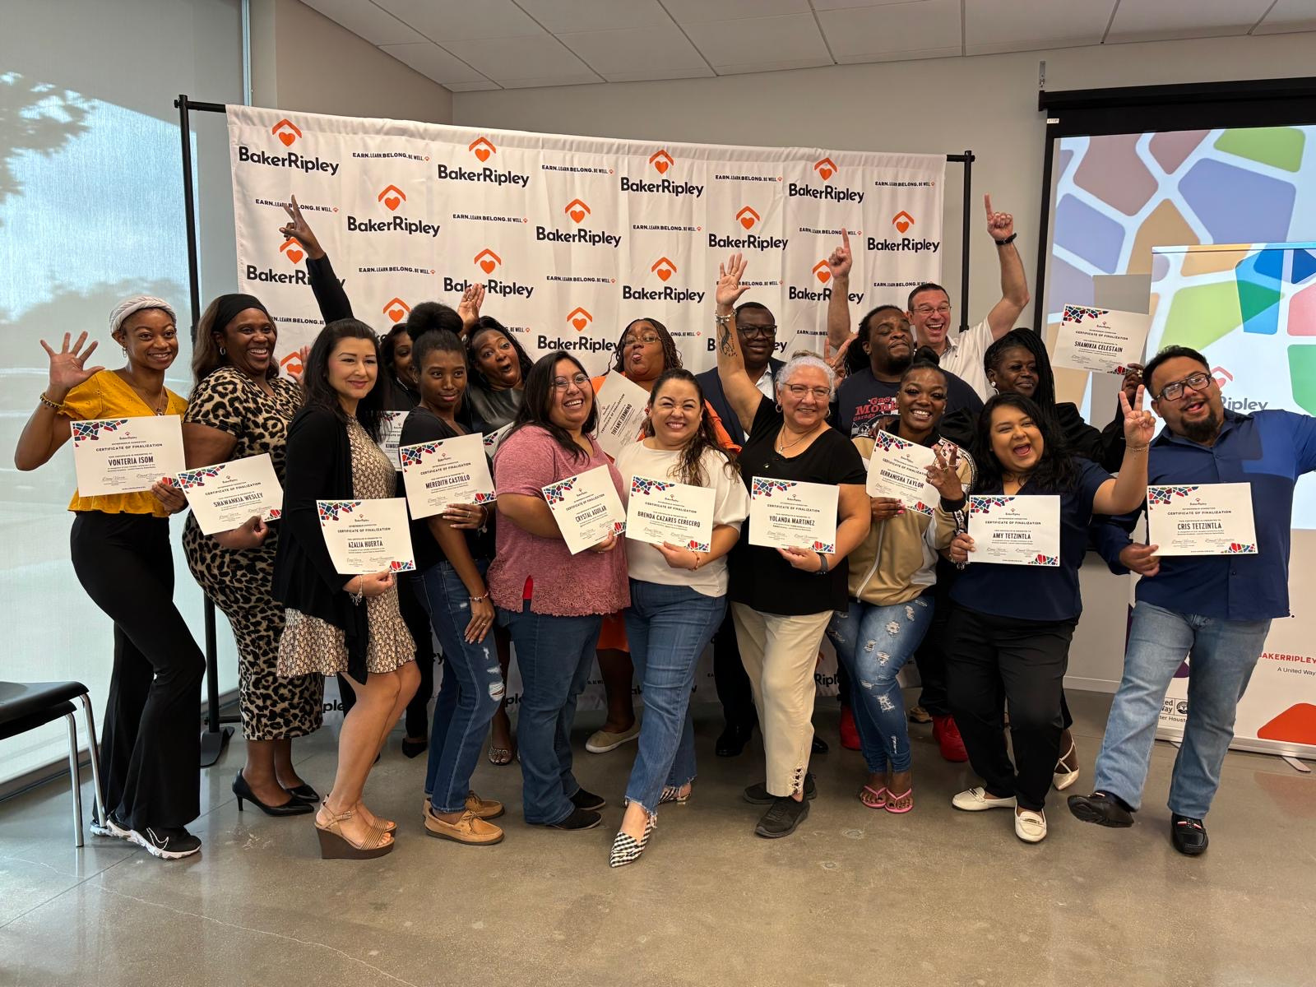


Education
program
  Entrepreneur Academy Lanzar​
  Entrepreneur Academy Crecer ​
  Entrepreneur Academy English
  Food Industry Resiliency Program (FIRP)
  Workshops & Outreach Events

Slide 5


BUSINESS PITCH
COMPETITIONs
  IgniteHTX Pitch Competition
  Lanzate Houston! Spanish Pitch Competition

Slide 6



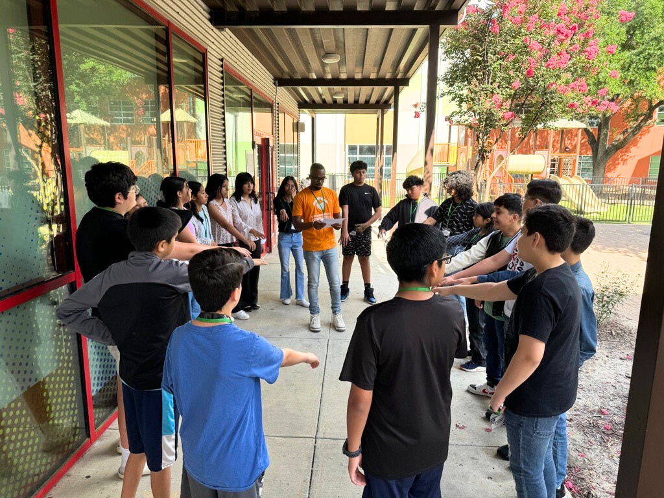



camp ignite
powered by venturelab

Slide 7
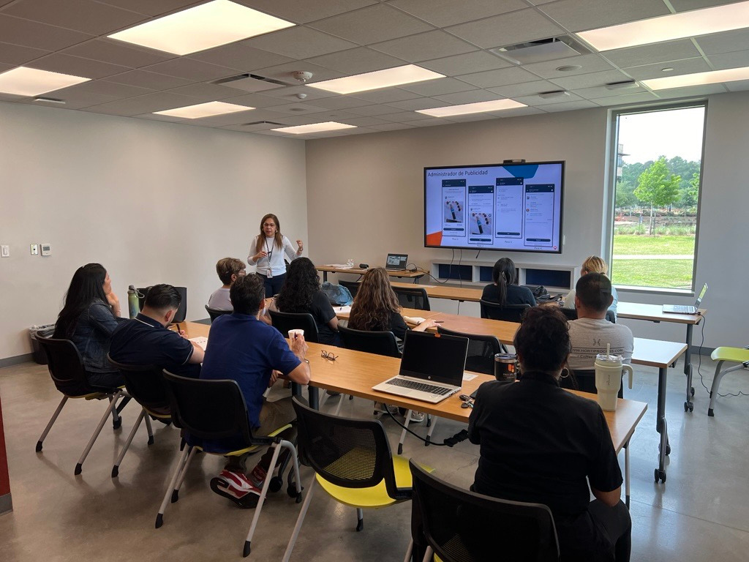
Technical Assistance Program Services​
The Technical Assistance Process is a strategic roadmap for achieving growth and expansion goals for a business owner’s and small businesses. ​

Slide 8






SALES PROCESS
PROCESS & OPERATIONS
FINANCIAL STRUCTURE & DEVELOPMENT
T.A.P sTRUCTURE
MARKETING DEVELOPMENT
AREAS OF DEVELOPMENT
ADMINISTRATIVE & oRGANIZATIONAL STRUCTURE
PRODUCTS/SERVICE DEVELOPMENT

Slide 9


T.A.P sTRUCTURE
BUSINESS LIFE CYCLE
bUSINESS gROWTH
sTART UP & fORMALIZATION
bUSINESS sTRUCTURE
bUSINESS eXIT
aNALYSIS & eXECUTION

Slide 10
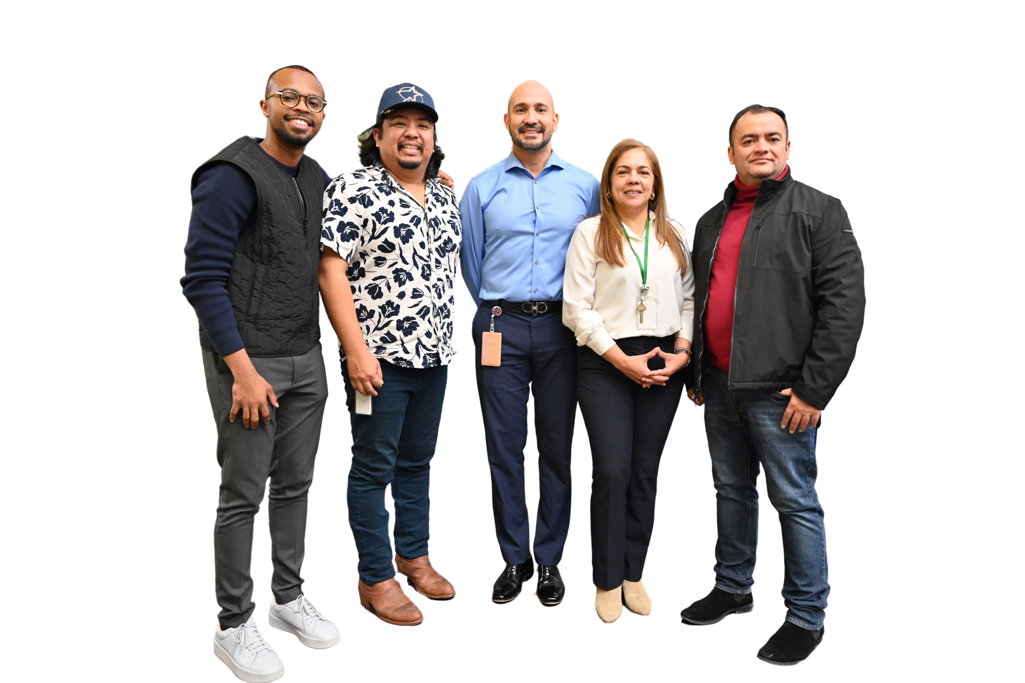


Technical Assistance Program
SCAN
HERE!

Slide 11
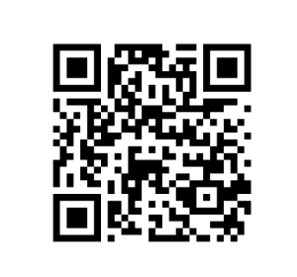

verizon small business digital ready

Slide 12


Slide 13


harris
hub
Program

Slide 14

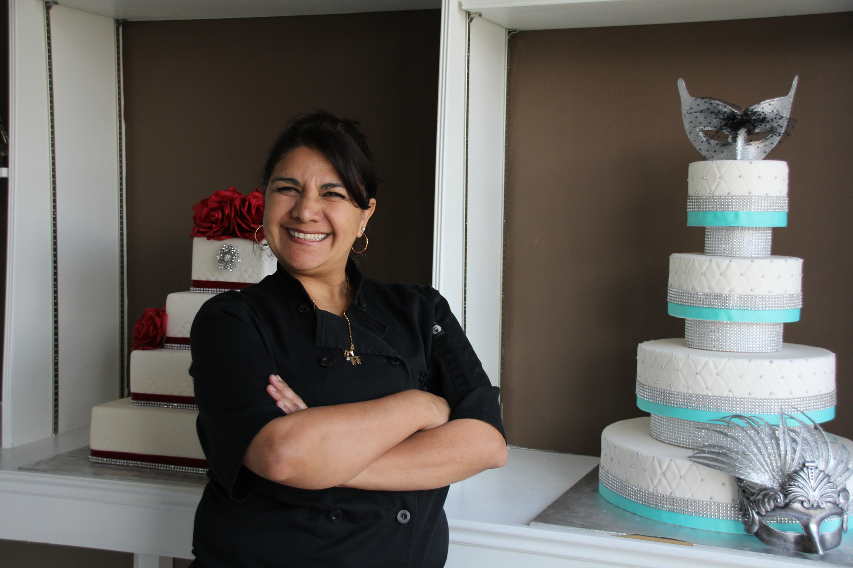


Harris Hub
Small Business Technical Assistance Program

Slide 15
Eligibility Requirements​
Applicant business must be:​
  A small business with 25 or fewer employees, including owners.​
  Recognized in Texas, and registered with Texas State Comptroller.​ Applicant must own 20% or more of the business.​
  Located within Harris County.​
  Operating at the time of COVID19 onset, January 27,2020.​
  Not a non profit, be gambling, speculative real estate investment, or a sexually oriented business.​
  Located in a Qualified Census Tract, or experienced a negative impact from COVID19.
  Applicant business owner’s personal net income must not exceed $1.32 million, annual, and ​
  Personal and/or Business Property taxes up to date or in a current payment plan if applicable.

Slide 16
Applicant’s Information​
  Valid Photo ID ​
  Most recently filed taxes documentation (2020, 2021, 2022, 2023), such as: ​
  Form 1040 or 1040 SR and Schedule C, Profit or Loss from Business (Sole Proprietorship), or ​
  Form 1040 or 1040 SR, Schedule F, Profit or Loss from Farming, or ​
  Form 1120, US Corporate Income Tax Return, or ​
  Form 1120, US Income Tax Return for S Corp ​

Slide 17
Applicant’s ​
Business Ownership​
Legal ​
Business Name​
  Business formation or incorporation documents (preferred) or​
  Form 1099, or ​
  Form 1040 or 1040 SR, Schedule C ​
  Vendor Identification Number​
  Federal Employer Identification Number (FEIN) (preferred) or​
  Texas Identification Number (TIN) ​

Slide 18
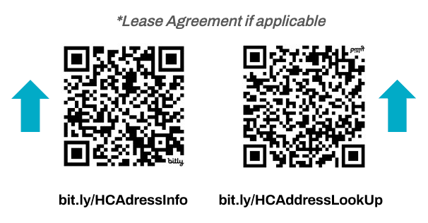
Type of Business ​
Size​
Business Location in Harris County​
&
  TYPE: North American Industry Classification System (NAICS) code, census.gov/naics/ and ​
  SIZE: W2, Tax form 940, 941, or Tax Wage Statement​

Slide 19
Operating at time of COVID and continuously operating since 2020
  Business corporation documents (DBA, Certificate of Formation), and ​
  IRS documentation 2020, 2021, 2022, 2023, 2024, and ​
  Lease Agreement, and/or ​
  Property tax documentation, and/or ​
  Utility bills ​

Slide 20
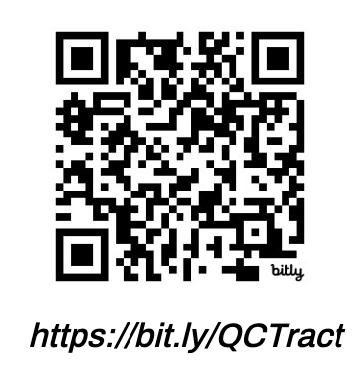

Proof of Business affected by COVID19​
Qualified ​
Census ​
Track (QCT)​
If business is not in QCT, applicant will need to fill out attestation in the application indicating that the business was affected​

Slide 21

TECHNICAL ASSISTANCE Requirements:​
  Creating plan and strategies during One on one coaching sessions​
  Attending group coaching sessions​
  Classes​
  Pitch Competitions​
*If you attend a workshop or any of our classes, please let your coach know. ​
30 hrs

Slide 22







process:
Preliminary Application
Business coach meeting
Submit Documentation
Document Reviewed
Eligible for the opportunity to be considered for a grant ​
Approved
Denied
Start TA Hours

Slide 23
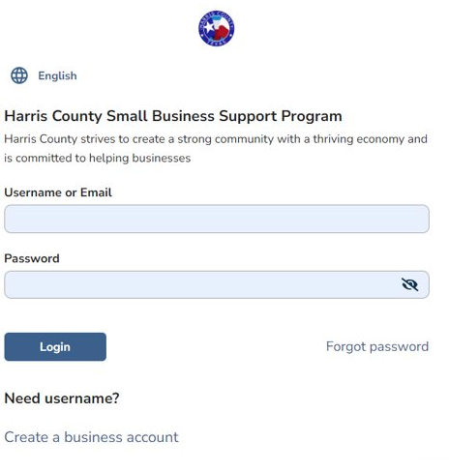
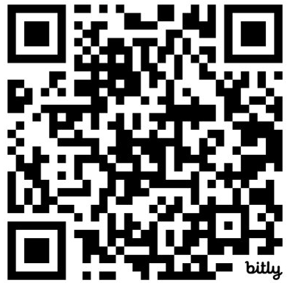
APPLICATION ​LINk
bit.ly/HarrisHUB​

Slide 24
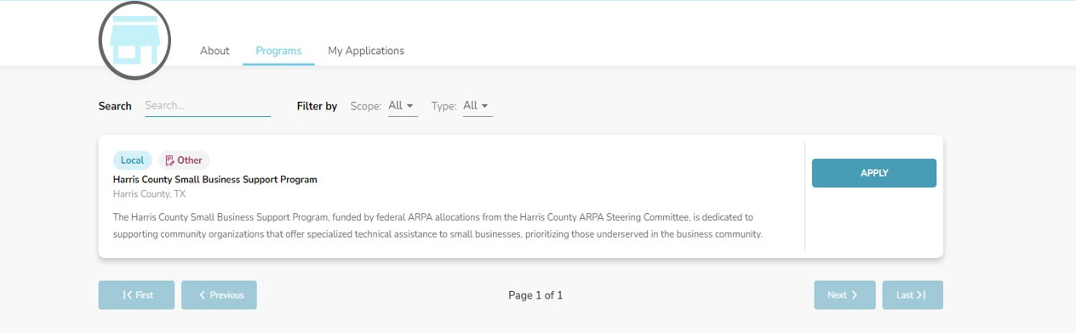
DOCUMENT SUBMISSION​

Slide 25
WHAT CAN YOU EXPECT?​
  Timeline​
  Communications​
  Process​
  Continuing Support​
  Development of action and business plan​
  Development of business strategies​
  Market analysis​
  Networking ​
  Capital connections

Slide 26




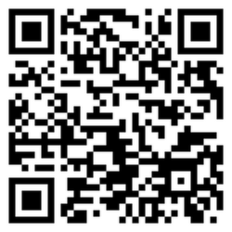
  One on one Coaching
  Classes and workshops
  Financial Stability mentoring
ENTREPRENEUR
CONNECTION PROGRAM
We provide resources, education and connections to capital to entrepreneurs.
connect with
our services today

Slide 27
QUESTIONS?​
CONTACT​
opportunity@bakerripley.org​​

Slide 28
thank
you

