Slide 1

HOW TO DO BUSINESS WITH HCDE
2024
May 16, 2024

Slide 2
AGENDA
2024
Introduction
About HCDE
Current Bid Opportunities
Steps to Become an Awarded Supplier
How to Receive Payment
Texas ISDs, Charter Schools & Governmental Entities
Questions

Slide 3
ABOUT US
2024
Our Goals
HCDE will:
Impact education by responding to the evolving needs of Harris County;
Deliver value to Harris County by utilizing resources in an ethical, transparent, and fiscally responsible manner;
Advocate for all learners by using innovative methods to maximize students’ potential;
Provide cost-savings for school districts by leveraging tax dollars; and
Recruit and maintain a high-quality professional staff
Our Mission
Harris County Department of Education supports Harris County by enriching educational opportunities and providing value through services.

Slide 4
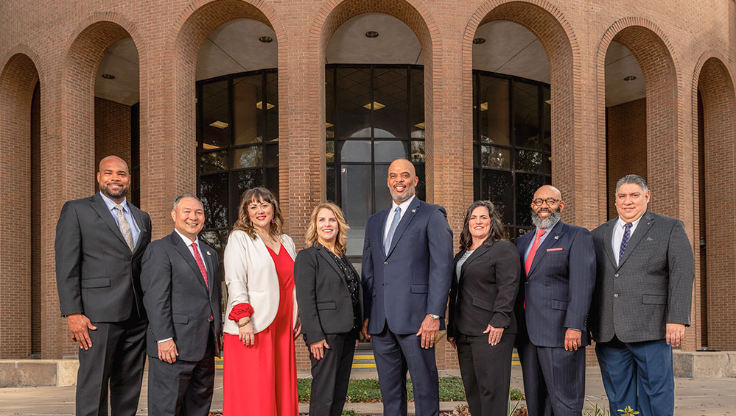
EXECUTIVE LEADERSHIP
2024

Slide 5

ADULT EDUCATION
2024
Basic Literacy
English Literacy
High School Equivalency
Citizenship
Distance Learning
Leadership
Workforce Certification Training
Phlebotomy
Medical Assistant Prep
Certified Nursing Assistant
Customer Service Marketing Representative
Heating Ventilation and Air Conditioning
Business Office Technology
Medical Billing and Coding
Front Office Specialist
Workforce Literacy
Workforce Workshops
Communication and Employability
Workbase Upskilling
1:1 Career Coaching and Support
Career Advising and Placement
Adult Education is a state- and federally-funded literacy program that consists of English Language, math, reading, writing and workforce training to help students acquire the skills needed to earn a high school equivalency diploma, enter college or to succeed in careers.

Slide 6

CENTER FOR AFTERSCHOOL, SUMMER AND ENRICHMENT
2024
Afterschool Strategic Investment
All-Earth Ecobot Challenge
CASE Debates
CASE for Kids City Connections
Level Up! Digital Badging Initiative
Partnership Project
Provider Network
Quality Improvement Resources
Texas 21st Century Community Learning Center

Slide 7

CENTER FOR EDUCATOR SUCCESS
2024
What We Do
CES was developed and designed to transform educator talent pipelines by partnering directly with districts to reimagine a comprehensive approach to educator recruitment, growth, advancement and leadership with the primary goal to inspire a new generation of educators to teach and lead in ways that generate real results and new opportunities for all children.

Slide 8

CENTER FOR SAFE AND SECURE SCHOOLS
2024
CSSS partners with federal, state and local entities to take the lead in the development of increased safety and security strategies, standards and best practices for K-12 school environments for both students and educators. CSSS continually seeks new and innovative opportunities to build safer and more secure learning environments.
The needs we address:
Criteria for Standards and Promising Practices
Emergency Management Planning and Operations
Communications, Coordination and Business Continuity
Training and Certification Programs
Assessments, Reviews and Audits
Safe and Secure Learning and Teaching Environment
Climate and culture are the undertow of schools and directly influence student belonging, teacher morale, parental involvement, and school safety

Slide 9

CONSTRUCTION SERVICES
2024
ABOUT US
The ultimate goal of construction services is to design and build safe and effective learning environments for students of all ages in Harris County..

Slide 10

HEAD START CENTERS
2024
Head Start provides newborns to 5-year-olds a safe learning environment that supports growth in many areas including language, literacy, and social and emotional development.
The Harris County Department of Education serves more than 1,300 students annually through the Head Start program with free healthy meals and snacks, vision, hearing, nutrition and developmental screenings, and physical activity indoors and outdoors in a healthy environment.

Slide 11

SCHOOL-BASED THERAPY SERVICES
2024
School-based Therapy Services supports children with disabilities and their families in the areas of occupational therapy, physical therapy and music therapy. This support comes through assessment, intervention, consultation, training and direct service in the classroom in a student's neighborhood school and district.

Slide 12

SPECIAL SCHOOLS
2024
The Schools Division partners with Harris County school districts to offer individualized learning through small-group instruction in highly structured classes. The goal is always for students to return to their home schools to graduate.
HCDE operates four special schools—Academic and Behavior Schools East, Academic and Behavior Schools West, Highpoint School East, and Fortis Academy—serving three populations of students:
those with severe emotional or physical disabilities;
troubled or adjudicated youth;
and students recovering from addiction.

Slide 13

WHAT DO WE NEED
2024
PROCURED CONTRACTS WITH HIGHLY QUALIFIED VENDORS AND SUPPLIERS

Slide 14
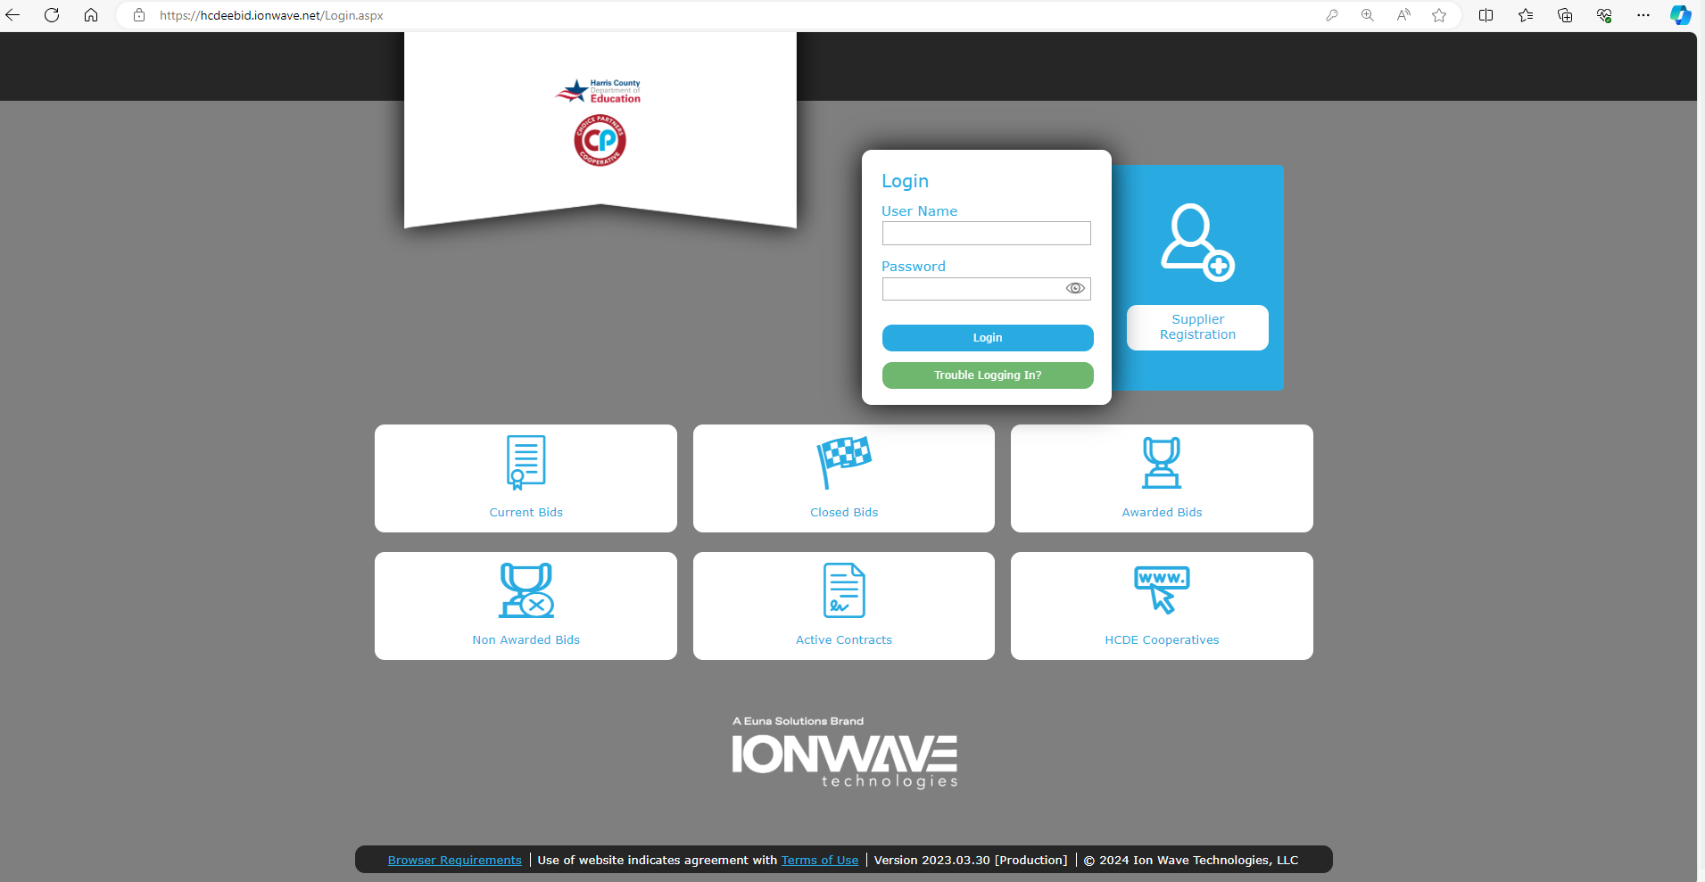
Current Bid Opportunities https://hcdeebid.ionwave.net/Login.aspx
2024
How to do Business with HCDE

Slide 15
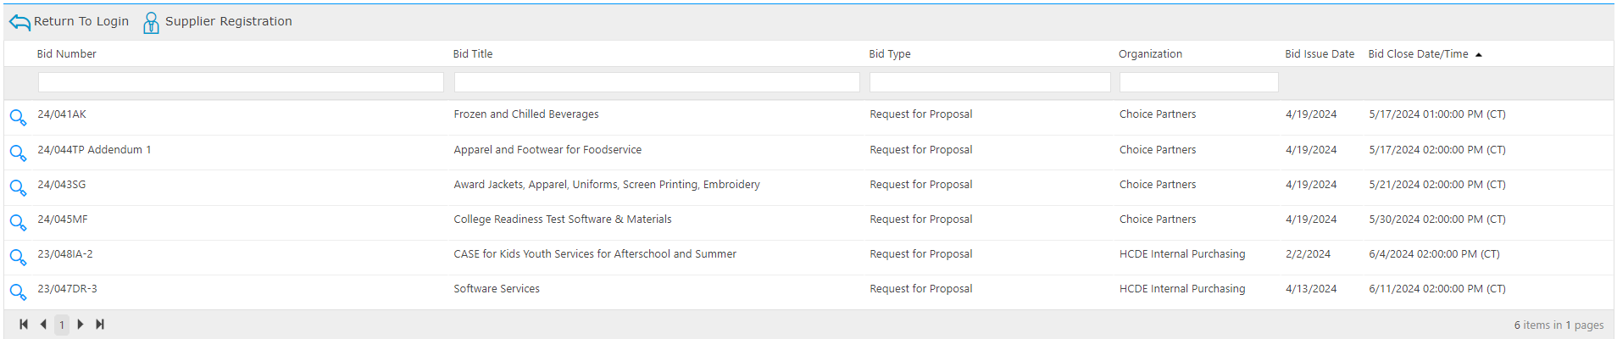
Current Bid Opportunities
2024
HCDE
How to do Business with HCDE

Slide 16






STEPS TO BECOME AN AWARDED SUPPLIER
2024
Step 1 Register
Step 2 Read Invitation
Step 3 Pre-proposal
Register in the HCDE eBid System.
Read the scope and specifications for each RFP invitation..
Attend pre-proposal conference and submit questions., if necessary.
Step 4 Submit Proposal
Step 5 Board Approval
Step 6 Contract/PO
If your services align with the scope and specifications, submit your proposal on or before deadline due date to be considered for award.
After proposals are evaluated, then committees submit recommendations to the Board of Trustees. Notifications are sent to awardees.
When your services are selected you will be asked to submit a contract and services may not begin until a purchase order has been sent to your firm..

Slide 17
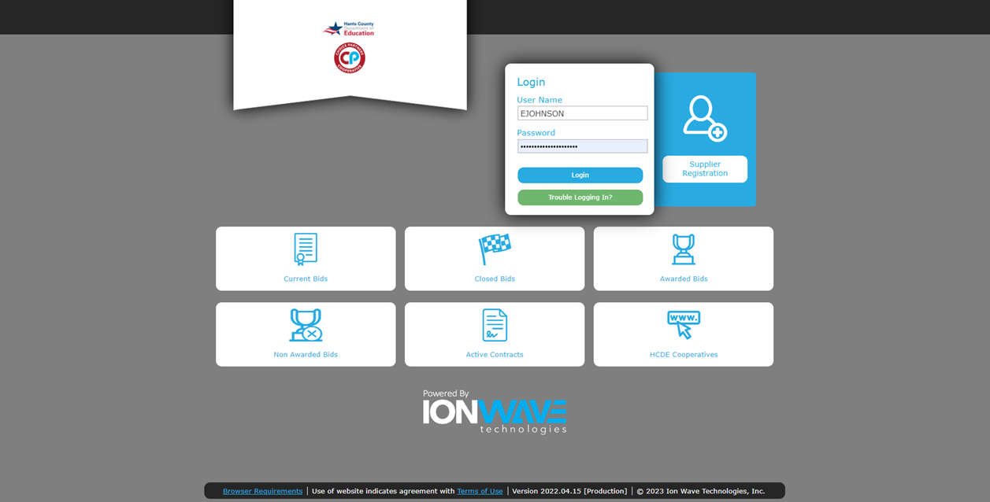
1. Register in HCDE’s eBid System
2024
HCDE eBid (ionwave.net)

Slide 18
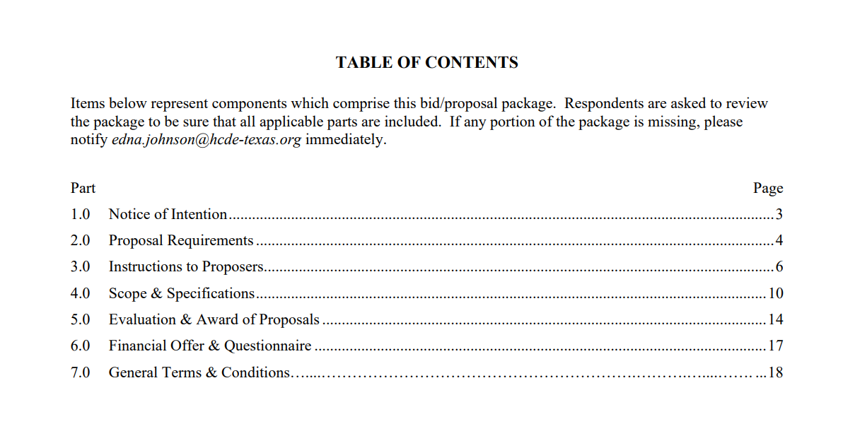
2. Read the RFP Invitation in its Entirety
2024
HCDE eBid (ionwave.net)

Slide 19

3. Attend Pre-proposal Conference
2024
HCDE eBid (ionwave.net)

Slide 20
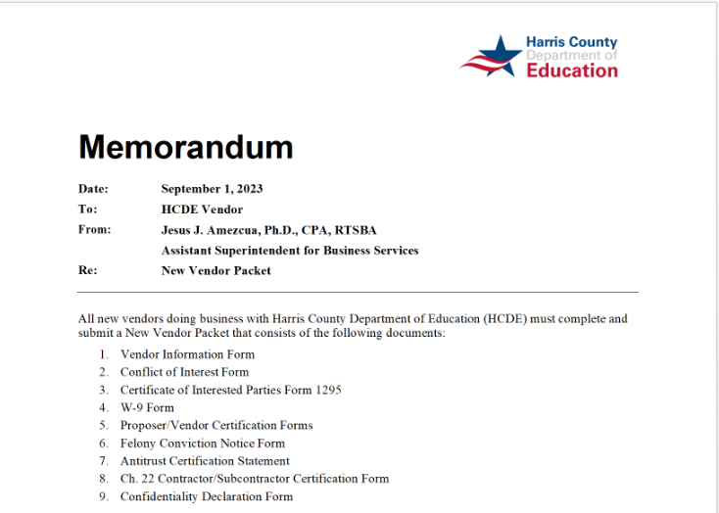
4. Submit Proposal and Required Forms
2024
HCDE eBid (ionwave.net)

Slide 21
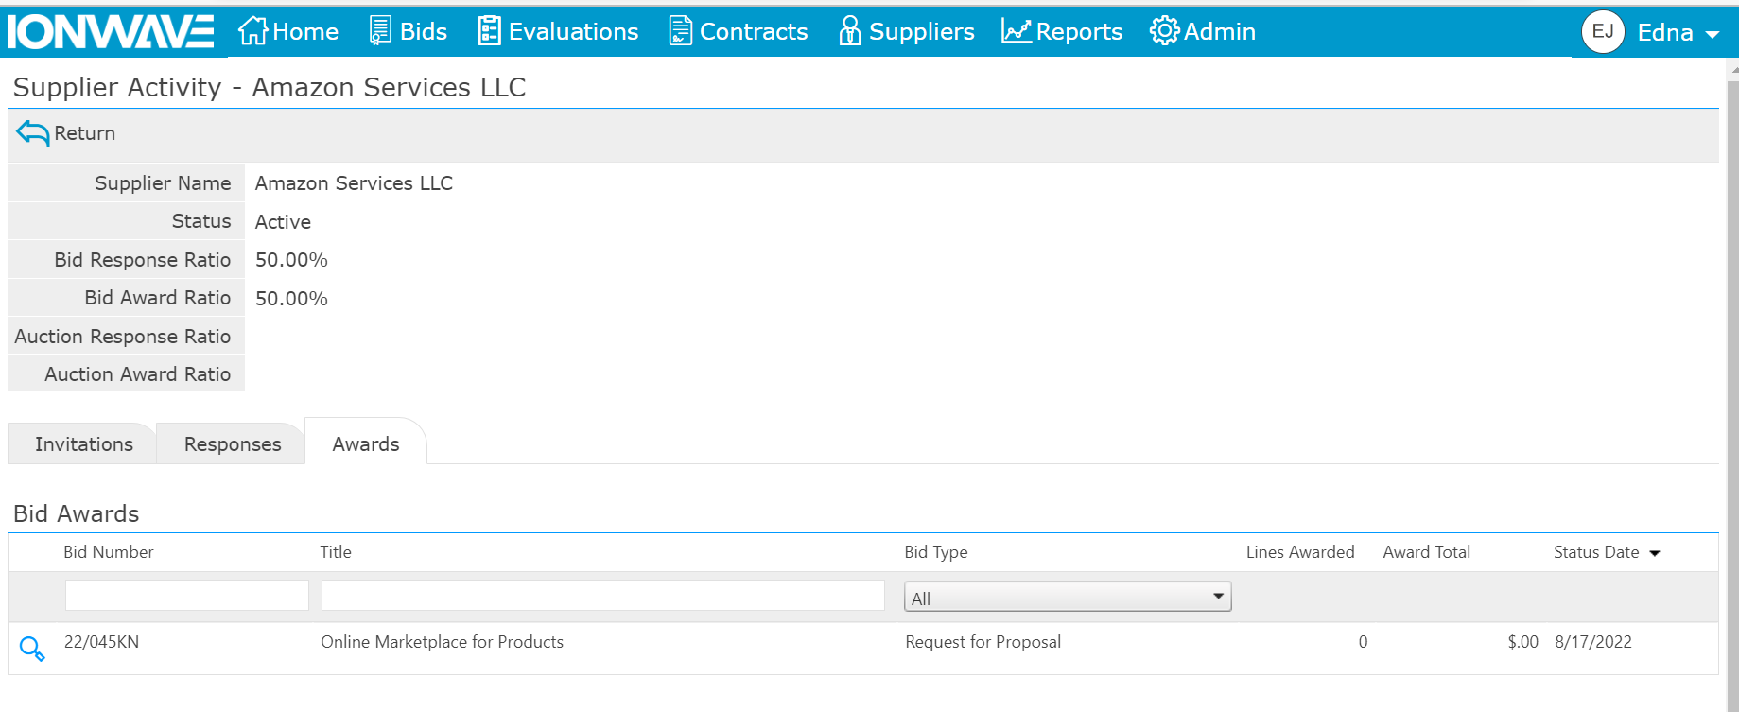
5. Board Approval and Award Notification
2024
HCDE eBid (ionwave.net)
Regular meetings of the HCDE Board are typically held on the third Wednesday of the month at 1 p.m. at 6300 Irvington Boulevard in Houston, Texas. Special meetings are called when necessary. All meetings are open to the public.
Awardee Notifications

Slide 22


6. Obtain Contract and Purchase Order
2024
HCDE eBid (ionwave.net)
All divisions within HCDE may submit contracts for services to any awarded supplier. However, services may not begin until contracts are fully executed, and purchase orders have been sent.
This Photo by Unknown Author is licensed under CC BY-SA

Slide 23

HOW TO RECEIVE PAYMENT
2024
SUPPLIERS ARE REQUIRED TO SUBMIT A COMPLETE VENDOR PACKET WITH EACH PROPOSAL. SUPPLIERS ARE REQUIRED TO NOTIFY HCDE IN WRITING OF ANY CHANGES.
This Photo by Unknown Author is licensed under CC BY-SA-NC

Slide 24

HOW TO RECEIVE PAYMENT
Submit Invoice for Services Rendered
7.20 Invoices; Payments
Invoices shall be directed to HCDE’s Accounts Payable Department.
All invoices shall be itemized to include the type of good(s) and/or service(s) rendered. Vendor shall submit invoices within a timely manner during HCDE’s fiscal year in which the good(s) and/or services are purchased.
In accordance with Texas Government Code § 2251.021, payments are due to Vendor within forty-five (45) days after the later of the following:(1) the date HCDE receives the goods under the Agreement; (2) the date the performance of the service under the Agreement is completed; or (3) the date HCDE receives an invoice for the goods or service.
Vendor agrees to pay any subcontractors, if any, the appropriate share of the payment received from HCDE not later than the tenth (10th) day after the date Vendor receives the payment from HCDE. The exceptions to payments made by HCDE and/or Vendor listed in Texas Government Code § 2251.002 shall apply to this Agreement.
2024
Render Services as stated in the Contract’s Scope of Work

Slide 25
Texas ISDs, Charter Schools and other Governmental Entities
2024
Texas Government Code 791
Saves time! Saves money!
Pursuant to applicable law, including the Interlocal Cooperation Act Chapter 791 of the Texas Government Code), HCDE may permit other governmental entities to “piggy-back” onto an existing contract between HCDE and Vendor entered into as a result of this RFP.
If another governmental entity chooses to utilize a contract established by this procurement solicitation and subsequent Agreement, contracts will be awarded individually by those governmental entities, and goods/services would be provided under the same contract pricing and purchasing terms established by this procurement solicitation.

Slide 26
QUESTIONS?
2023

Slide 27
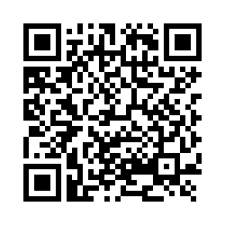
How did we do?
2024
Satisfaction Survey

Slide 28
THANK YOU!
2024

