Slide 1
Financial Highlights
As of August 31, 2025

Slide 2

Highlights of Interim Financial Report (unaudited)
Preliminary - prior to accruals and year end adjustments -
August 31, 2025

Slide 3





Posted on Our Website
Finance / Monthly Finance Reports (hcde-texas.org)
Linked from State Comptroller’s website
http://www.texastransparency.org/local/schools.php

Slide 4
Top 15 Highlights points for August 2025
$0K in tax revenue this month
Next Debt Svc payment is Feb 2026
GF Revenues at 90%
GF Expenditures at 83%
$38M in Equity(F Bal) as of August 2025
$38,740 August Donations
Values at $653B out of $665B Projected
Choice at $10.2M Benefit Variance
Ed Foundation at $238K in Equity
12% small business -August 25
99% Irvington Project
Phase I Projects – just pending retainage release and closeout
Tax Calendar and public hearing to be scheduled
IPASS for Sept 12, 2025
ASBO Award for the Comprehensive Annual Financial Report - # 22 in a row
NOTE: Preliminary amounts before FY closing
Outlook Trend : Finance - Tax Revenues being received – Projected to utilize fund balance for operations given unrealized revenues
Revenues and exp. Below target
Operations - Normal Operations
Legislative - Assessing Impact to HCDE
Finance - Assessing grant awards pending

Slide 5
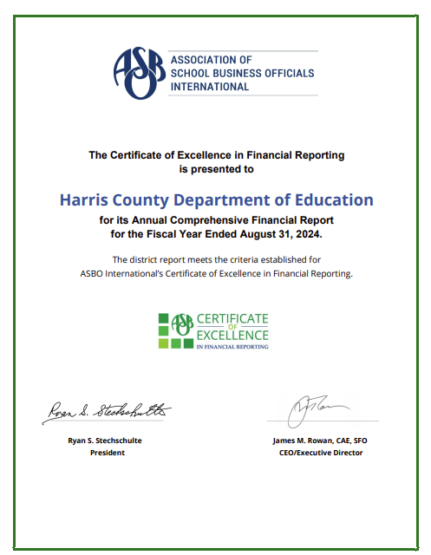
ASBO International Award
# 22 in a Row

Slide 6
Budget & Tax Calendar
Budget related dates
June 24, 2025 - Budget Submission & Board Budget Workshop
August 25, 2025 - Preliminary Values $689B -> Projected in budget $688B
Est. NNR .004725 (.004798) VAR .005127 Final Calculations
August 30, 2025 - Board Workshop & Budget Adoption
Aug 20, 2025 - Board Mtg - Consider approval of: (1) certification of the anticipated tax collection rate, ( anticipated debt collection rate for excess debt collections, (3) calculation of the no-new-revenue rate and voter-approved rates by the Harris County Tax Assessor/Collector
Aug 25, 2025 - Tax Values to be received - Received on Sept 3, 2025
Sept 10, 2025 - Consider approval of: (4) 2025 Certified Property Values and the submission of the no-new-revenue tax rate and voter-approval tax rate using the certified estimate of taxable value, and (5) a plan to adopt a tax rate of $0.004798 for Tax Year 2025 in accordance with the Truth in Taxation laws codified in Chapter 26 of the Texas Tax Code as amended by the 89th Legislature.
October 7,2025 Posting Notice for Public Hearing and Adoption
October 15, 2025 - Public Hearing
October 15, 2025 – Consider approval to adopt the tax rate .004798. – Required 60% motion to
approve. 5/7
Tax related dates

Slide 7
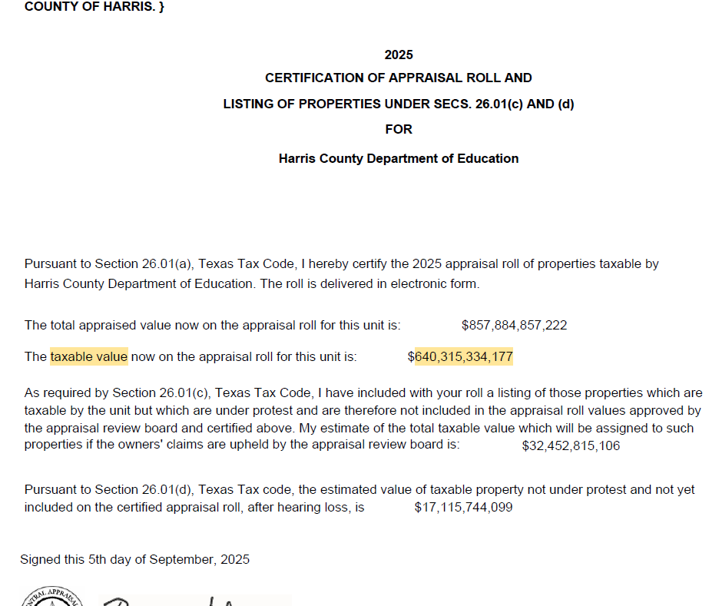
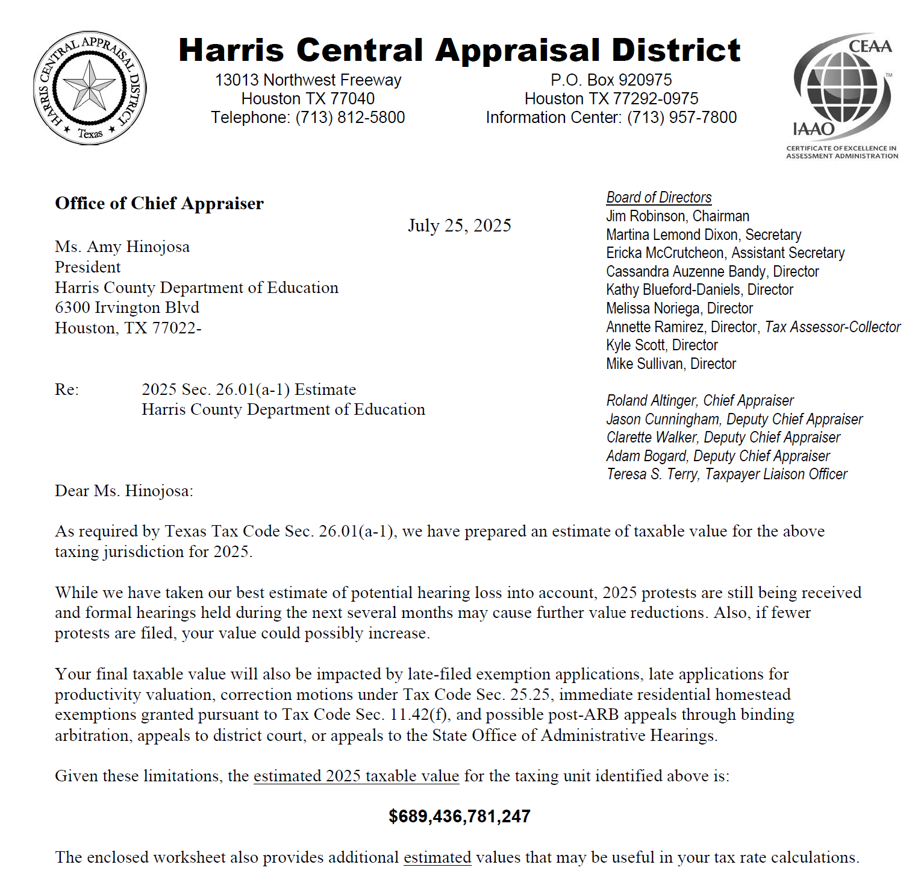
Preliminary Values $689 Billion
Projected in Budget $688 Billion
Certified values received on Sept 3th.

Slide 8
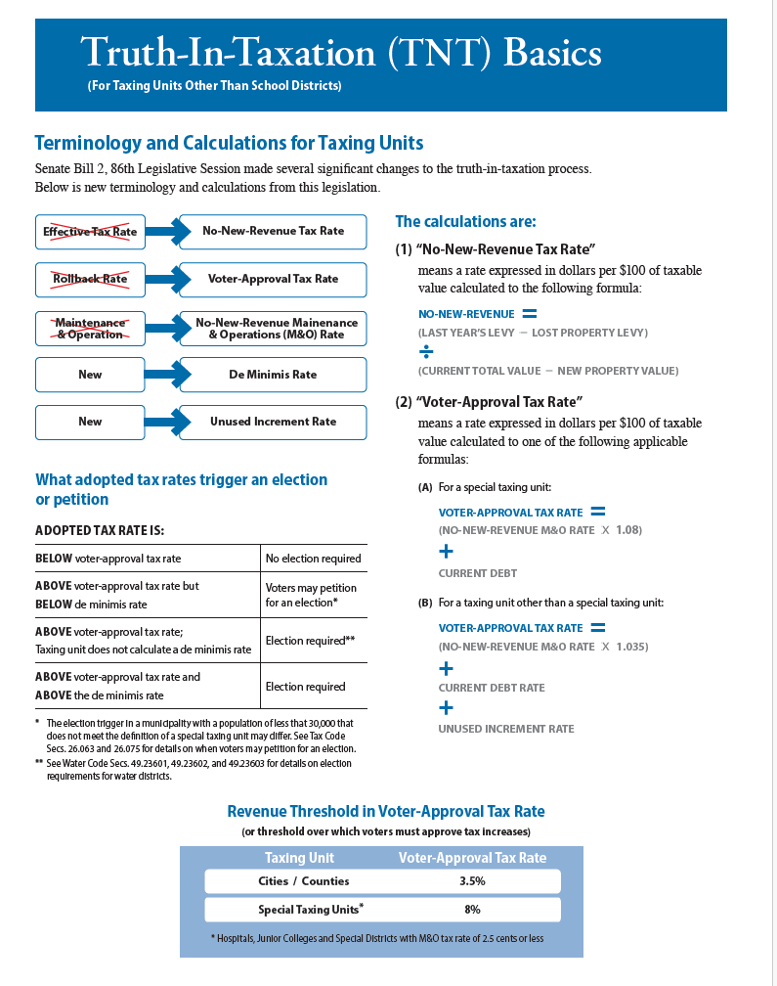

Slide 9
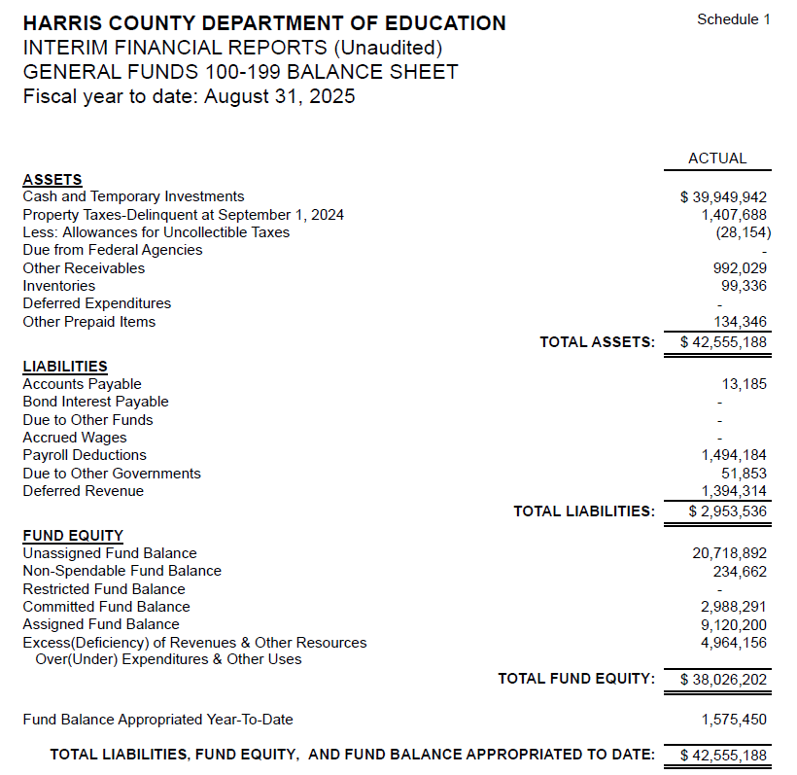
INTERIM FINANCIAL REPORT
(unaudited)
GENERAL FUND
Balance Sheet as of August 31, 2025
Total Assets:
$ 42,555,188
Total Liabilities:
$ 2,953,536
Total Fund Equity:
$38,026,202

Slide 10
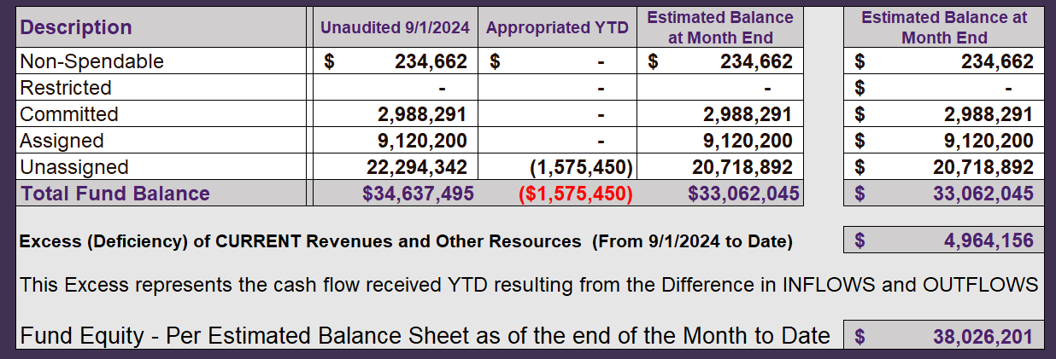
INTERIM FINANCIAL REPORT (unaudited)
ASST. SUPERINTENDENT FOR BUSINESS SERVICES MESSAGE
As of August 31, 2025
The ESTIMATED General Fund balance at 08/31/2025 is $42,272,572 after current appropriations.
As year end adjustments are completed, a budget amendment will be submitted to the board for items assigned, restricted and committed that will roll forward into FY 2025.

Slide 11
INTERIM FINANCIAL REPORT (unaudited)
As of August 31, 2025
Financial Ratios
Level One - Indicator of Financial Strength
Level Two - Indicator of Efficient Leverage
Level Three - Indicators of Efficiency
Level Four - Indicators of Revenue Growth

Slide 12
INTERIM FINANCIAL REPORT (unaudited)
As of August 31, 2025
Indicators of Financial Strength
Percent of Fund Balance to G/F
Expenditures Ratio
What is the percent of rainy-day fund balance?
(*) Unadjusted
Working Capital Ratio
What is the cash flow availability for the organization?
Goal : >$15,000,000
Benchmark : $10M to $15M
Danger : Under < $10M
Unassigned Fund Balance $20,718,892
Total G/F Expenditures $65,831,613
Goal : > 30% of G/F Exp.
Benchmark: 10% to 29%
Danger: Under 10%
Total Current Assets
Less Total Current Liabilities
$42,555,188 - $2,953,536= $39,601,652
31% FY25
27% FY24
$39M FY25
$35M FY24
Budgeted 29%
Details on Schedule 3
Budgeted $33M
Details on Schedule 1

Slide 13
INTERIM FINANCIAL REPORT (unaudited)
As of August 31, 2025
Indicators of Efficient Leverage Reserves
Unassigned Fund Balance Ratio
How much is available in reserves?
Debt to Income Ratio
What is the ability of HCDE to cover
its debt payments?
Goal: <25% of annual revenue
Benchmark: 25% to <49%
Danger: Over > 50%
Unassigned Fund Balance $20,718,892
Total Fund Balance $39,601,652
Goal: <75%
Benchmark: 50% to 75%
Danger: <50%
Annual Principal and Interest Payments on
Term Debt and Capital Leases : $2,598,038
G/F Revenue Less Facility $70,795,770-6,499,961
Charges :
52% FY25
46% FY24
4% FY25
5% FY24
Budgeted 30%
Details on Schedule 1
Budgeted 5%
Details on Schedule 5

Slide 14
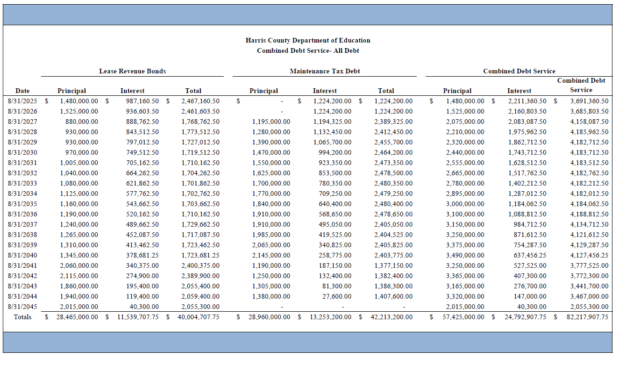
Combined Debt

Slide 15
INTERIM FINANCIAL REPORT (unaudited)
As of August 31, 2025
Indicators of Efficiency
Tax Revenue to Total Revenue Ratio
How efficient is HCDE at leveraging local
taxes? (Current)
Indirect Cost to Tax Ratio
How much dependency on indirect cost from grants?
Current Tax Revenue $30,912,946 Total Revenue $127,452,366
Indirect Cost General Fund $2,191,176
Total General Fund Revenues $70,795,770
Goal: <20% of revenue
Benchmark: 20% to 30%
Danger: Over >30%
Goal: >5%
Benchmark: 2% to 5%
Danger: Under < 2%
24% FY25
21% FY24
3.1% FY25
2.9% FY24
Budgeted 20%
Details on Schedule 2
Budgeted 3.6%
Details on Schedule 3

Slide 16
INTERIM FINANCIAL REPORT (unaudited)
As of August 31, 2025
Indicators of Revenue Growth
Fee for Service Revenue Ratio
How are revenues spread across all Funds?
Fee for Service Revenue Growth Ratio
What is the market growth for fee on services?
Total Fee for Service Revenues (G/F) $23,192,123
Total Revenues $127,452,366
Fee for Service Current Year Less Fee for Services Last Year $23,192,123-25,822,234
Fees for Service Last Year $25,822,234
Goal: >30% of annual revenue Benchmark: 10% to 29%
Danger: Under 10%
Goal: >3% of + growth
Benchmark: 0% to 3%
Danger: Under 0%
18% FY25
17% FY24
-10% FY25
17% FY24
Budgeted 39%
Details on Schedule 14
Budgeted 17%
Details on Schedule 14

Slide 17
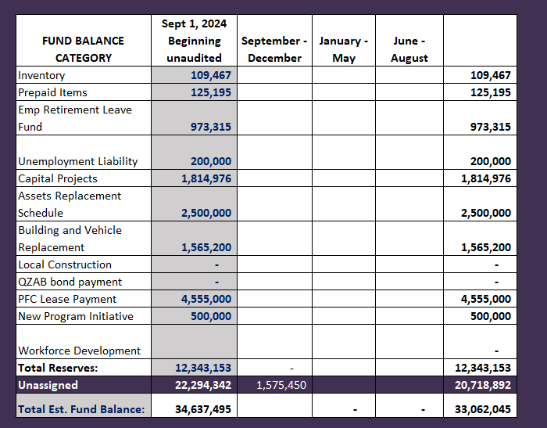
FY 2024-2025
Fund Balance
-
Budgeted Activity
Previous Bas
Leadership Academy in Crosby | $ 350,000
Prairie view Grant match | $ 41,000
Facilities | $ 230,000
Tax | $ 1,000,000
New NPO HVAC System | $ 1,789,450
AB EAST | $ 1,700,000
AB WEST | $ 285,000
Benefits | $ 150,000
HeadStart Place Holder | $ 400,000
HeadStart Place Holder | $ (400,000)
Adult Ed Place Holder | $ 267,717
Adult Ed Place Holder | $ 16,287
Capital Project | $ 249,472
Capital Project | $ 361,969
Capital Project | $ 2,151,419
Choice Partners | $ 2,685,000

Slide 18
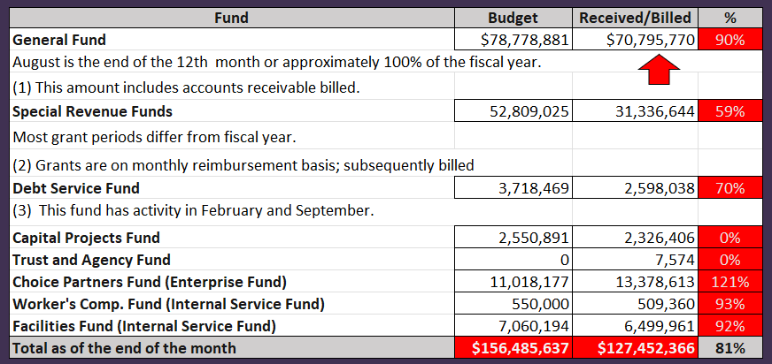
INTERIM FINANCIAL REPORT (unaudited)
GENERAL, SPECIAL REVENUE, DEBT SERVICE FUNDS, CAPITAL PROJECTS,
AND INTERNAL SERVICE FUNDS
REVENUES (INFLOWS)
Budget to Actual for period ending August 31, 2025

Slide 19
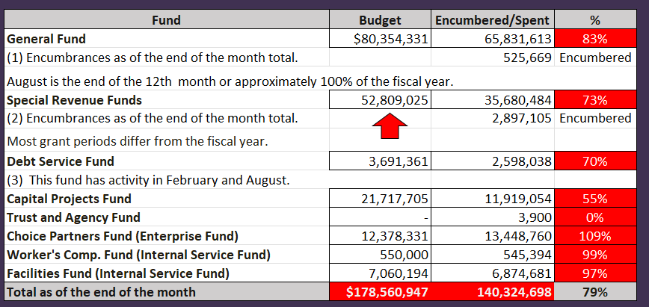
INTERIM FINANCIAL REPORT (unaudited)
GENERAL, SPECIAL REVENUE, DEBT SERVICE FUNDS, CAPITAL PROJECTS,
AND INTERNAL SERVICE FUNDS
Expenditures (OUTFLOWS)
Budget to Actual for period ending August 31, 2025

Slide 20
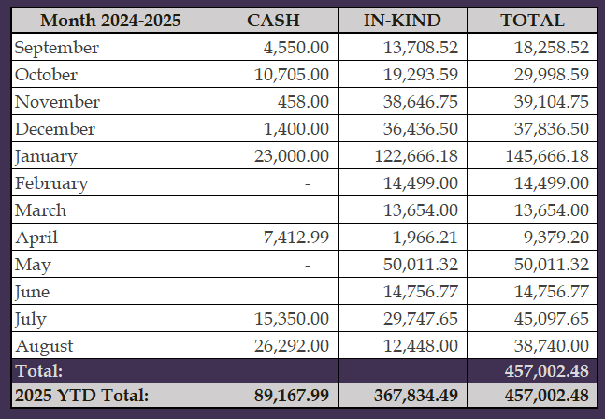
INTERIM FINANCIAL REPORT (unaudited)
FY 2024-25 Donations Report
All Funds as of August 31, 2025

Slide 21
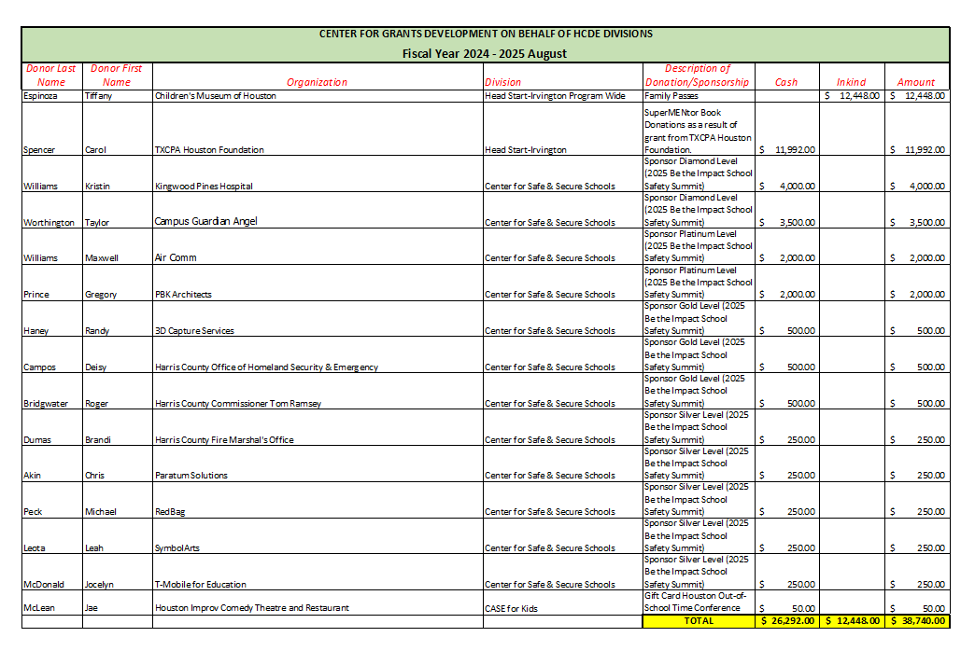
INTERIM FINANCIAL REPORT (unaudited)
FY 2024-25 Donations Report
All Funds as of August 31, 2025

Slide 22
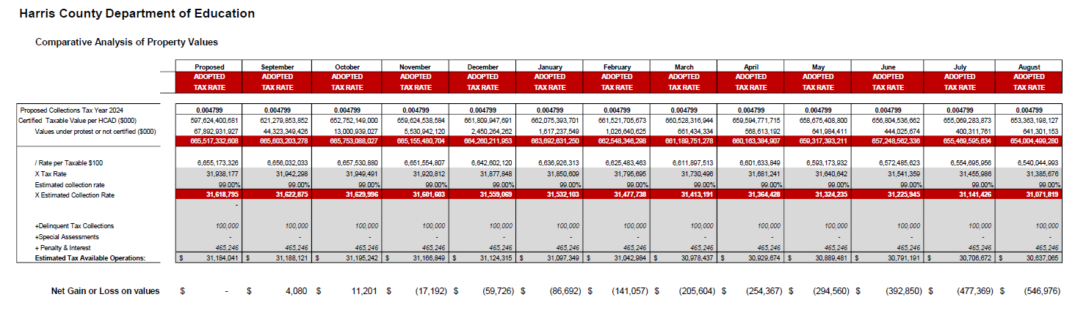
INTERIM FINANCIAL REPORT (unaudited)
TAX COLLECTIONS COMPARATIVE ANALYSIS
Fiscal Year-To-Date as of August 31, 2025
$665B
$653 B
See Tax Calculator at:
https://hcde-texas.org/transparency/tax-rate/

Slide 23
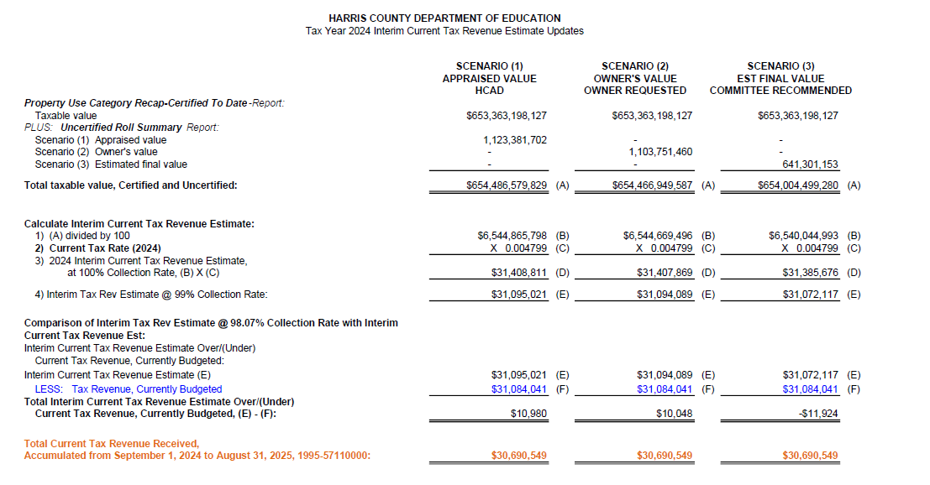
INTERIM FINANCIAL REPORT (unaudited) TAX COLLECTIONS
Fiscal Year-To-Date as of August 31, 2025
(12th month / 12 months)

Slide 24
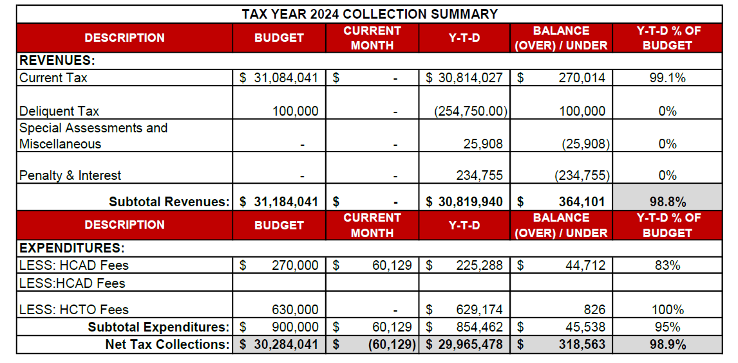
INTERIM FINANCIAL REPORT (unaudited) TAX COLLECTIONS
Fiscal Year-To-Date as of August 31, 2025
(12th month / 12 months)
a) 2024 Approved Tax Rate = $0.004799/$100 Property Assessment/Appraisal - --> Annual Tax on a $259,375 - $51,875 = $207,500/100
x .004799 = $9.958 (net of 20% homestead exception.)
b) $850,000/$32,184,041 = 2.64% Collection and assessment costs

Slide 25
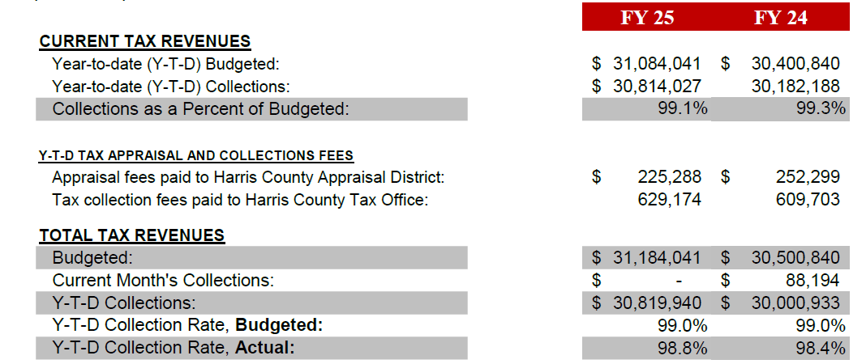
INTERIM FINANCIAL REPORT (unaudited) TAX COLLECTIONS
Fiscal Year-To-Date as of August 31, 2025
(12th month / 12 months)
a) 2024 Approved Tax Rate = $0.004799/$100 Property Assessment/Appraisal - --> Annual Tax on a $259,375 - $51,875 = $207,500/100
x .004799 = $9.958 (net of 20% homestead exception.)
b) $850,000/$32,184,041 = 2.64% Collection and assessment costs

Slide 26
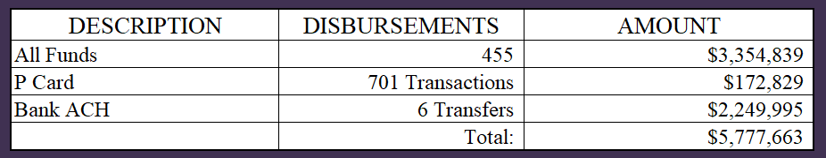
INTERIM FINANCIAL REPORT (unaudited)
DISBURSEMENT – ALL FUNDS
August 31, 2025
Notes:
All Purchase Orders and Payment Authorizations are reviewed before disbursement.
All Procurement Card charges are reviewed by cardholder, supervisor, and business office staff each month.
A report on CH Local Expenditures is included in the monthly report.

Slide 27
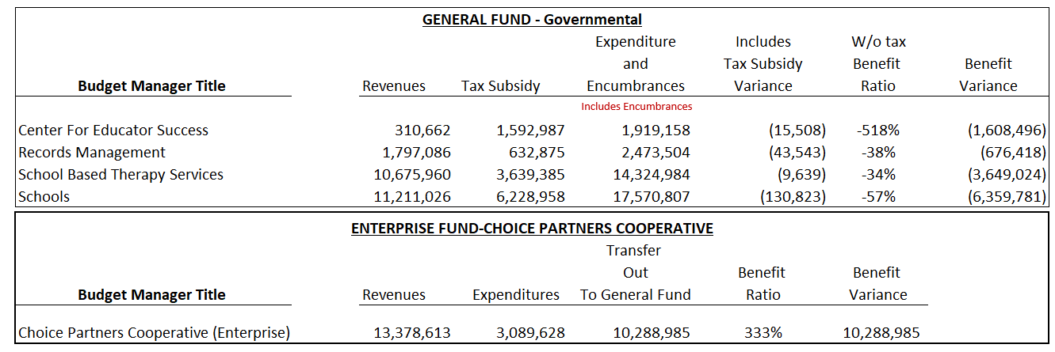
INTERIM FINANCIAL REPORT (unaudited)
Segment Division Data
As of August 31, 2025

Slide 28
HIGHLIGHTS OF BUDGET AMENDMENT REPORT
September 10th, Board Meeting
(unaudited)
NO BUDGET AMENDMENTS

Slide 29

Education Foundation Update
August31st, 2025

Slide 30
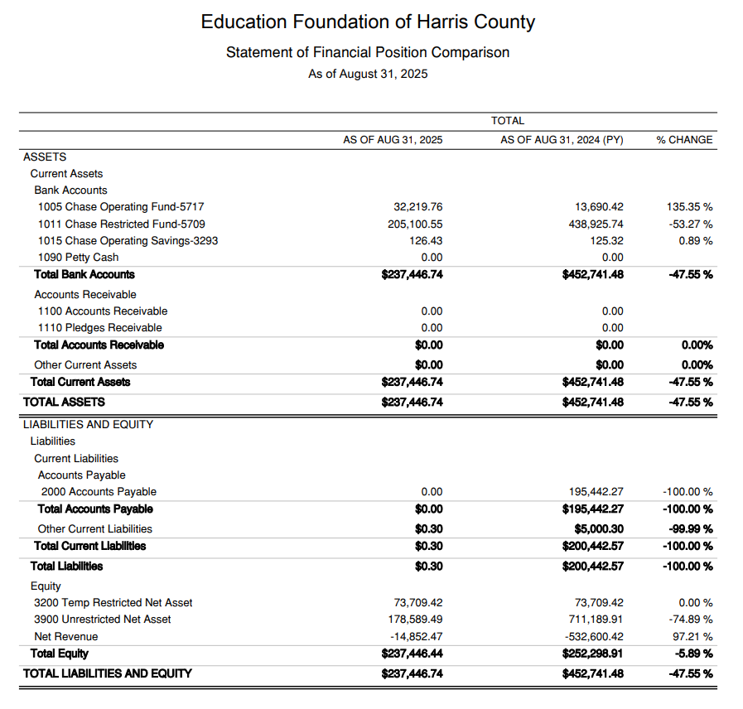
Statement of Financial Position
Net Equity
$238,446

Slide 31
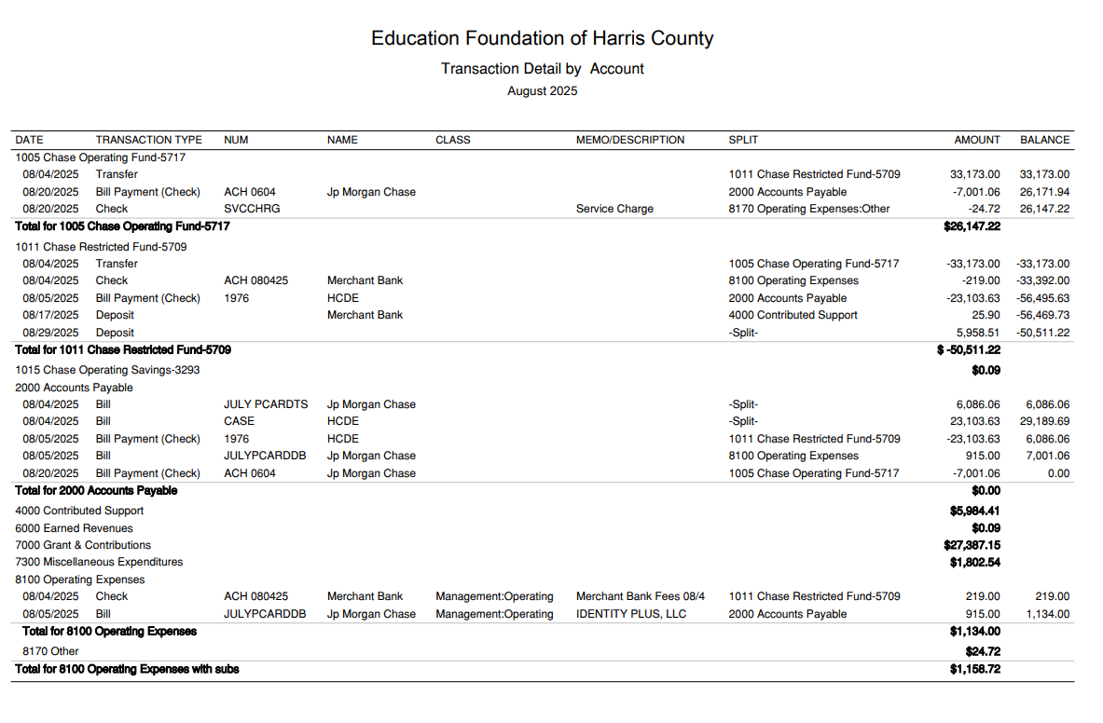
Transaction Detail by Inflow & Outflow

Slide 32
PFC & LEASE REVENUE PROJECTS UPDATE
August31st, 2025

Slide 33
Small Business Report FY2024-25
09/01/24 to 08/31/25
Submitted by:
Dr. Edna E. Johnson,
Procurement Services Director

Slide 34
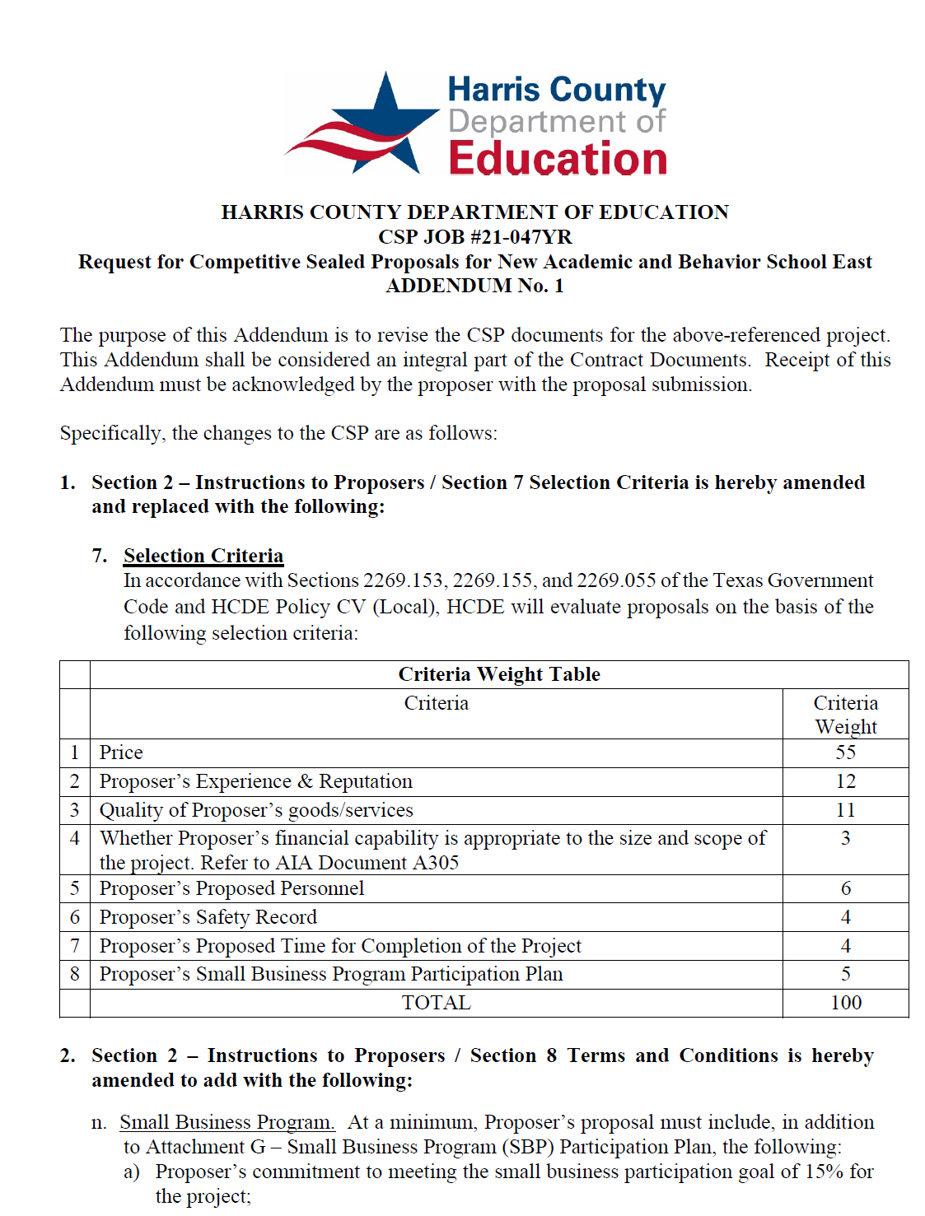
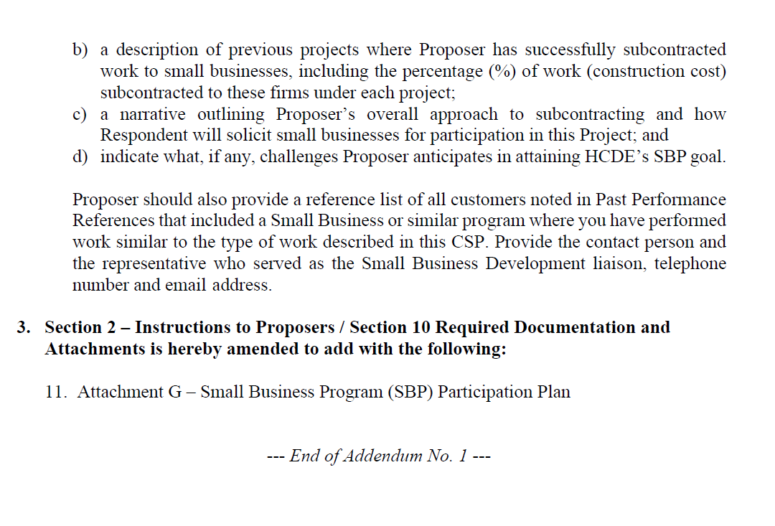
Small Business
for Construction
Launch industry's first collaboration feature
This is our plan as we launch the industry's first collaboration feature

Slide 35
Content
Small Business Expenditures for FY2024-25 Year to Date (09/01/24 to 08/31/25)
Graphic
List of Small Businesses

Slide 36
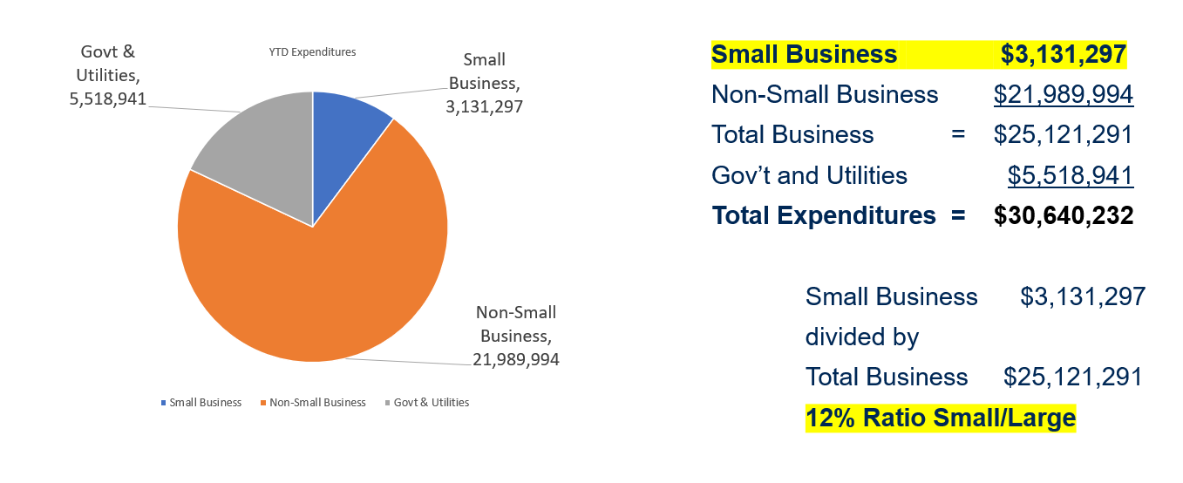
Expenditures FY 2024-25
(09/01/24 to 08/31/2025)

Slide 37
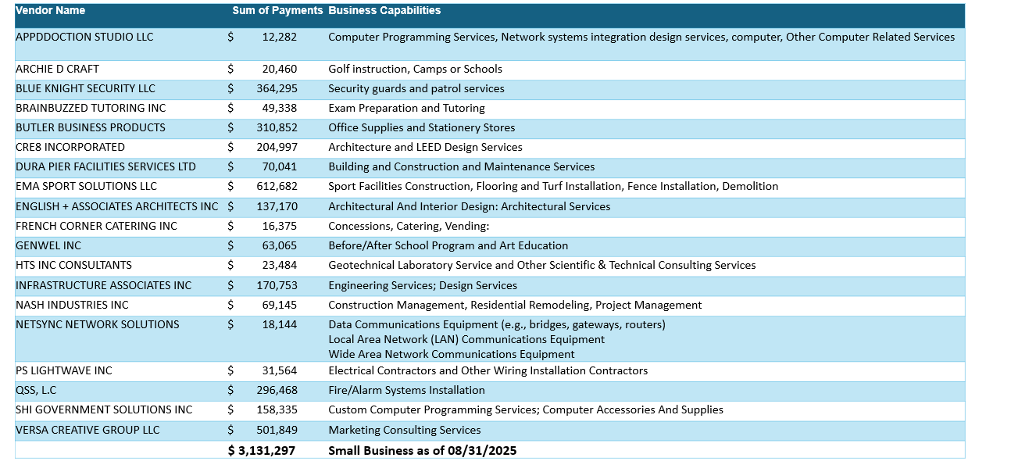
List of Small Businesses
FY 2024-25

Slide 38
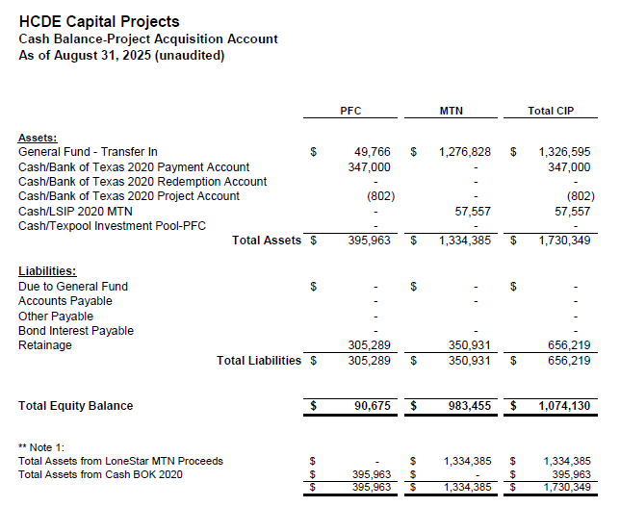

AB East School Contract $12,358,000 Awarded
Adult Ed Center Contract $15,121,000 Awarded on Oct 2021 Board Mtg
HP East Contract $7,271,000 Awarded on Nov 2021
Irvington – $11,172,589 Awarded on Jan 2024
Cash Balance –
Project Acquisition Account
As of August 31, 2025
38

Slide 39
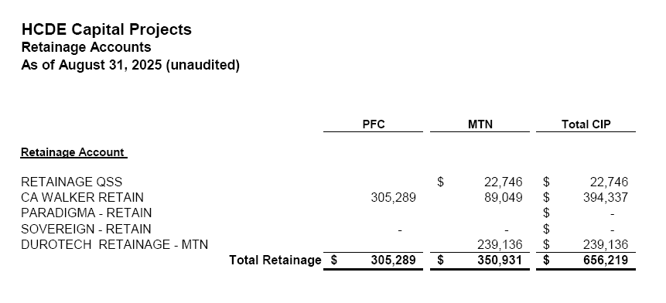
2020 MTN NOTES/2020 PFC BONDS
Pending Retainage Payable
Retainage Payable
Project Acquisition Account
As of August 31, 2025
39

Slide 40
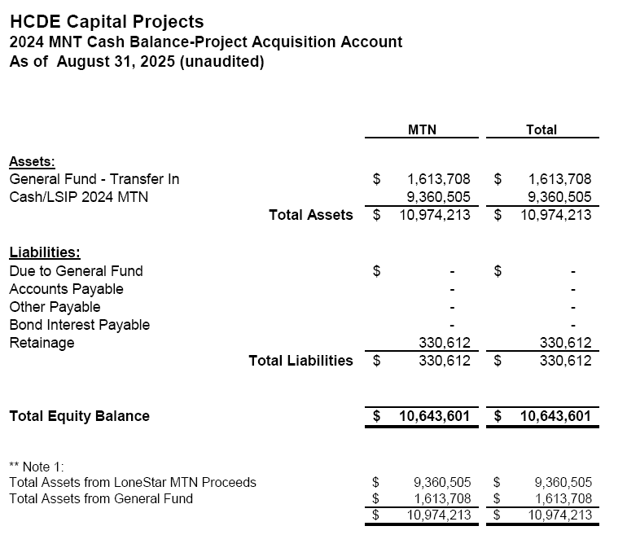
AB West $333,000 March 2024 Board Mtg
HS Barrett Station $470,000 March 2024 Board Mtg
Fortis Academy $650,000 March 2024 Board Mtg
Irvington – $9,860,000 March 2024 Board Mtg
Post Oak - $5,000,000 March 2024 Board Mtg
$16,313,000
Cash Balance –
2024 Maintenance Notes
As of August 31, 2025
40

Slide 41
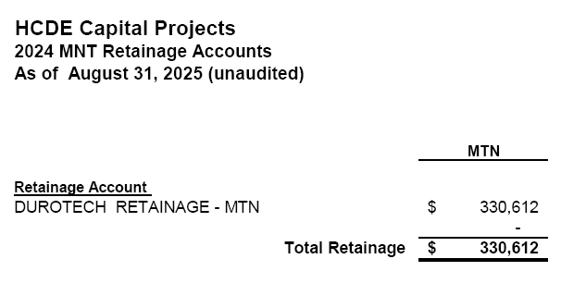
AB West $333,000 March 2024 Board Mtg
HS Barrett Station $470,000 March 2024 Board Mtg
Fortis Academy $650,000 March 2024 Board Mtg
Irvington – $9,860,000 March 2024 Board Mtg
Post Oak - $5,000,000 March 2024 Board Mtg
$16,313,000
Retainage Payable
2024 Maintenance Notes
As of August 31, 2025
41

Slide 42
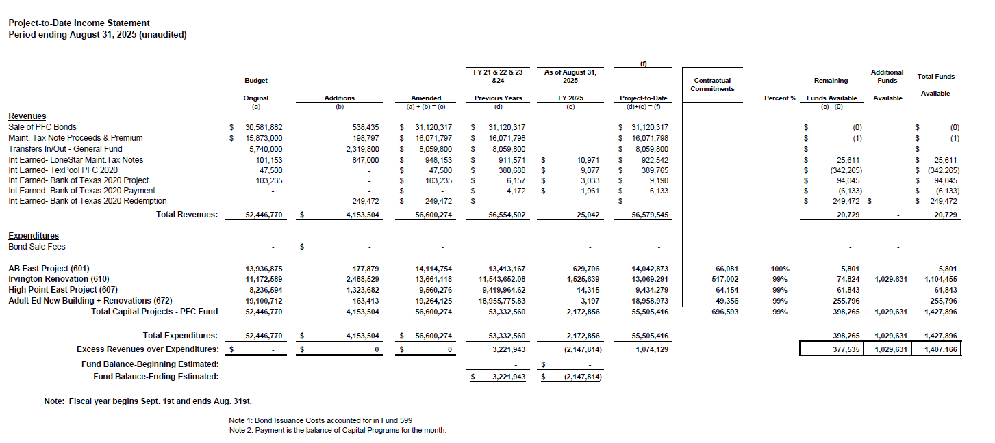
Income Statement– Project Acquisition Account
As of August 31, 2025
42

Slide 43
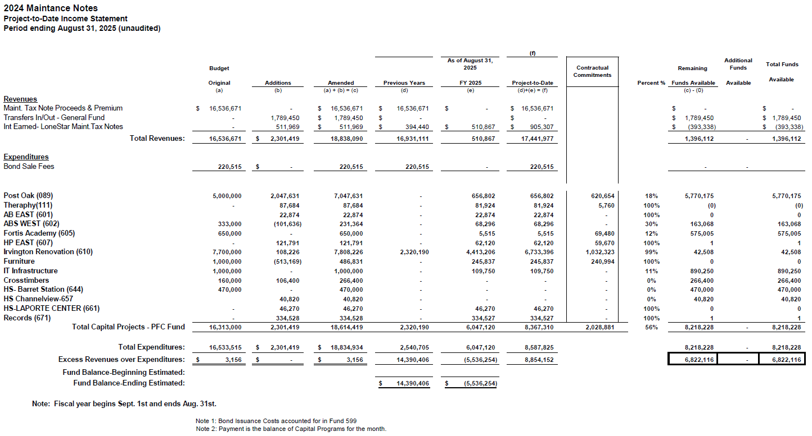
Income Statement– 2024 MNT NOTES
As of August 31, 2025
43

Slide 44
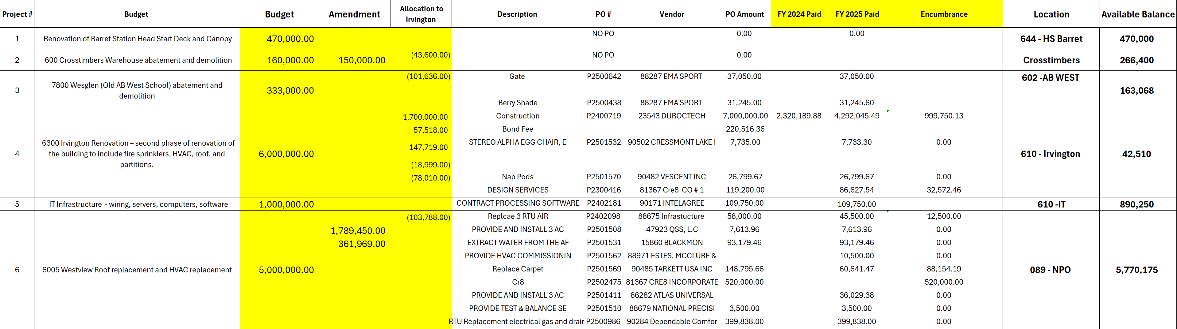
Maintenance Notes 2024 – Projects
44

Slide 45
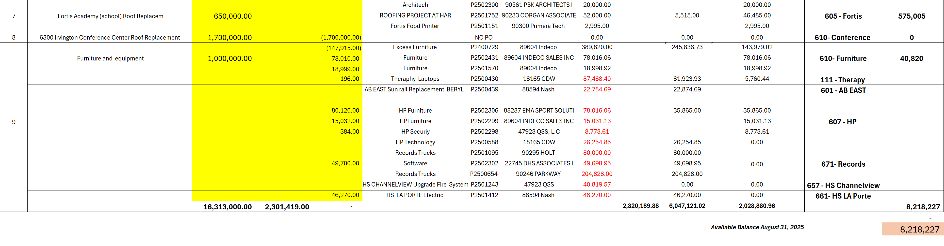
Maintenance Notes 2024 – Projects
45

Slide 46
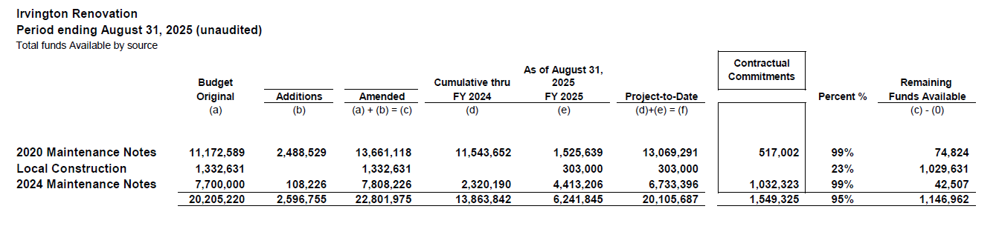
Irvington Renovation – Funds by Source
As of August 31, 2025

Slide 47


Interim Financial Report (unaudited)
I certify that the foregoing information is true and accurate to the best of my knowledge.
/s/ Jesus J. Amezcua, RTSBA,CPA, Ph.D., CPFIM, Asst. Supt. for Business Support Services
/s/ Marcia Leiva, Chief Accounting Officer

