Slide 1


Financial Highlights
As of June 30, 2025

Slide 2

Highlights of Interim Financial Report (unaudited)
June 30, 2025

Slide 3





Posted on Our Website
Finance / Monthly Finance Reports (hcde-texas.org)
Linked from State Comptroller’s website
http://www.texastransparency.org/local/schools.php
Official Notice Coming Soon
3

Slide 4
Top 14 Highlights points for June 2025
9. Ed Foundation at $266K in Equity
10. 13% small business-June 25
11. 99% Irvington Project
12. Phase I Projects – just pending retainage release and closeout
13. Board Budget for adoption
14. One Budget amendments for approval
$112K in tax revenue this month
Next Debt Svc payment in August
TOT Revenues at 72% Target of 83%
TOT Expenditures at 66% Target of 83%
$44M in Equity(F Bal) as of June 2025
$14,756 June Donations
Values at $656B out of $665B Projected
Choice at $8.5M Benefit Variance
Outlook Trend : Finance - Tax Revenues being received – Projected to utilize fund balance for operations given unrealized revenues
Revenues and exp. Below target
Operations - Normal Operations
Legislative - Assessing Impact to HCDE
Finance - Assessing grant awards pending
4

Slide 5
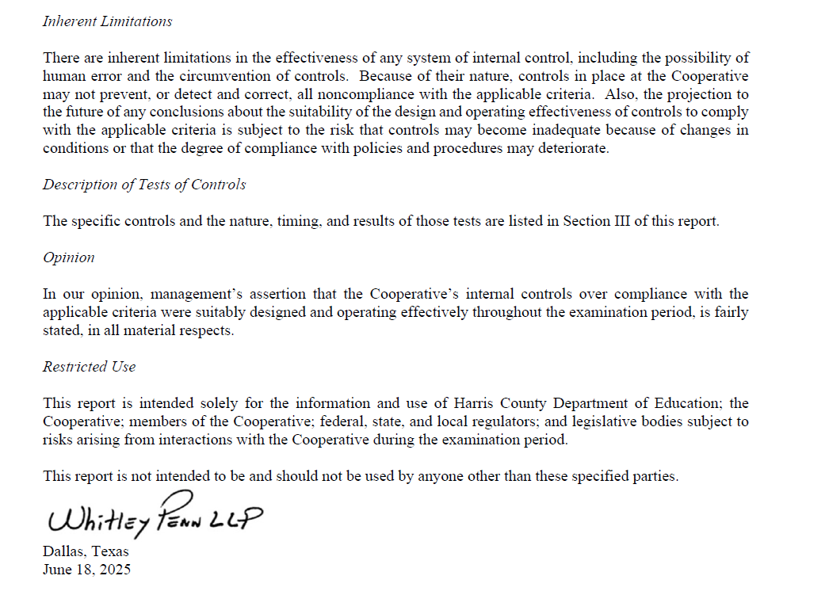
Choice Audit

Slide 6
Budget Calendar
June 30, 2025 - Budget Submission
June 24, 2025 - Board Workshop
July 16, 2025 - Board Workshop & Budget Adoption
Aug 25, 2025 - Tax Values to be received
Sept 17, 2025 - Tax Rate adoption tentatively (if no
additional public hearings are required
6

Slide 7

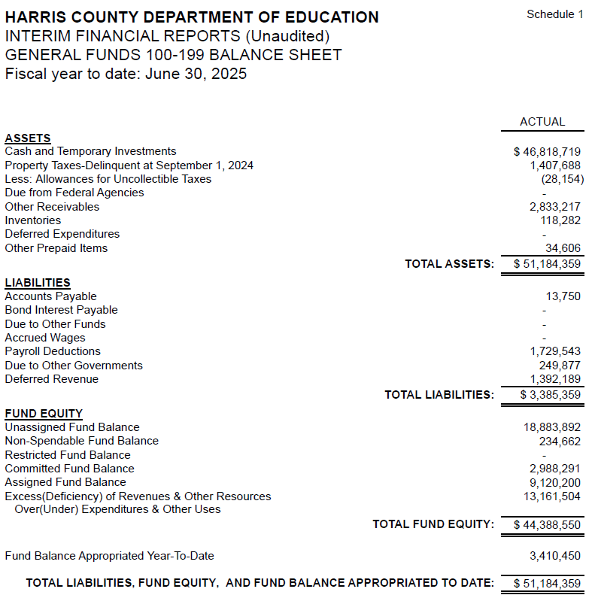
INTERIM FINANCIAL REPORT
(unaudited)
GENERAL FUND
Balance Sheet as of June 30, 2025
Total Assets:
$ 51,184,359
Total Liabilities:
$ 3,385,359
Total Fund Equity:
$ 44,388,550

Slide 8
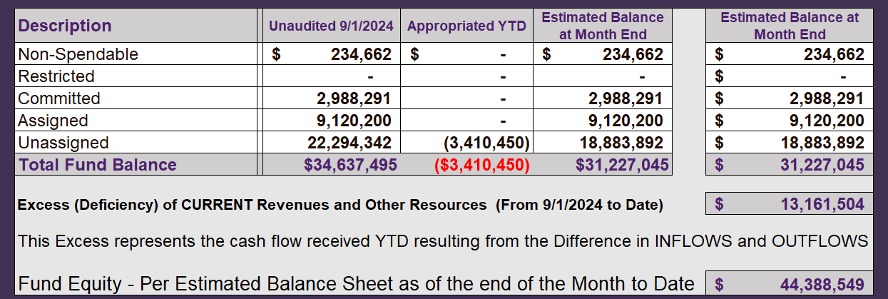
INTERIM FINANCIAL REPORT (unaudited)
ASST. SUPERINTENDENT FOR BUSINESS SERVICES MESSAGE
As of June 30, 2025
The ESTIMATED General Fund balance at 06/30/2025 is $44,388,549 after current appropriations.
As year end adjustments are completed, a budget amendment will be submitted to the board for items assigned, restricted and committed that will roll forward into FY 2025.
8

Slide 9
INTERIM FINANCIAL REPORT (unaudited)
As of June 30, 2025
Financial Ratios
Level One - Indicator of Financial Strength
Level Two - Indicator of Efficient Leverage
Level Three - Indicators of Efficiency
Level Four - Indicators of Revenue Growth

Slide 10
INTERIM FINANCIAL REPORT (unaudited)
As of June 30, 2025
Indicators of Financial Strength
Percent of Fund Balance to G/F
Expenditures Ratio
What is the percent of rainy-day fund balance?
(*) Unadjusted
Working Capital Ratio
What is the cash flow availability for the organization?
Unassigned Fund Balance $ 18,883,892
Total G/F Expenditures $ 52,449,121
Goal : > 30% of G/F Exp.
Benchmark: 10% to 29%
Danger: Under 10%
Goal : >$15,000,000
Benchmark : $10M to $15M
Danger : Under < $10M
Total Current Assets
Less Total Current Liabilities
$51,184,359-$3,385,359 =$47,799,000
36% FY25
33% FY24
$47M FY25
$32M FY24
Budgeted 29%
Details on Schedule 3
Budgeted $33M
Details on Schedule 1

Slide 11
INTERIM FINANCIAL REPORT (unaudited)
As of June 30, 2025
Indicators of Efficient Leverage Reserves
Unassigned Fund Balance Ratio
How much is available in reserves?
Debt to Income Ratio
What is the ability of HCDE to cover
its debt payments?
Unassigned Fund Balance $18,883,892
Total Fund Balance $47,799,000
Annual Principal and Interest Payments on
Term Debt and Capital Leases : $2,598,038
G/F Revenue Less Facility $65,610,626-5,514,821
Charges :
Goal: <75%
Benchmark: 50% to 75%
Danger: <50%
Goal: <25% of annual revenue
Benchmark: 25% to <49%
Danger: Over > 50%
40% FY25
39% FY24
4.3% FY25
4% FY24
Budgeted 30%
Details on Schedule 1
Budgeted 5%
Details on Schedule 5

Slide 12
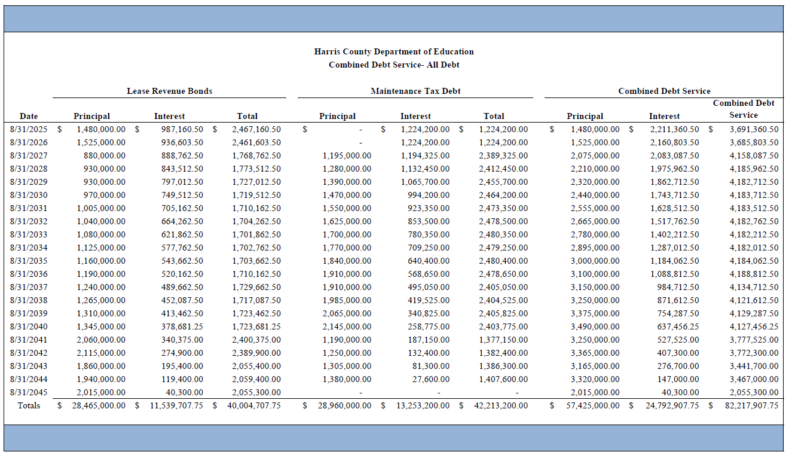




Combined Debt

Slide 13
INTERIM FINANCIAL REPORT (unaudited)
As of June 30, 2025
Indicators of Efficiency
Tax Revenue to Total Revenue Ratio
How efficient is HCDE at leveraging local
taxes? (Current)
Indirect Cost to Tax Ratio
How much dependency on indirect cost from grants?
Current Tax Revenue $30,873,814
Indirect Cost General Fund $1,817,585
Total Revenue $ 111,123,949
Total General Fund Revenues $65,610,626
Total General Fund Revenues $1,306,381
Goal: <20% of revenue
Benchmark: 20% to 30%
Danger: Over >30%
Goal: >5%
Benchmark: 2% to 5%
Danger: Under < 2%
Goal: >5%
Benchmark: 2% to 5%
Danger: Under < 2%
27% FY25
23% FY24
2.8% FY25
2.5% FY24
Budgeted 20%
Details on Schedule 2
Budgeted 3.6%
Details on Schedule 3

Slide 14
INTERIM FINANCIAL REPORT (unaudited)
As of June 30, 2025
Indicators of Revenue Growth
Fee for Service Revenue Ratio
How are revenues spread across all Funds?
Fee for Service Revenue Growth Ratio
What is the market growth for fee on services?
Total Fee for Service Revenues (G/F) $20,079,394
Total Revenues $111,123,949
Fee for Service Current Year Less Fee for Services Last Year $22,079,394-24,848,066
Fees for Service Last Year $24,848,066
Goal: >30% of annual revenue Benchmark: 10% to 29%
Danger: Under 10%
Goal: >3% of + growth
Benchmark: 0% to 3%
Danger: Under 0%
19% FY25
19% FY24
-11% FY25
20% FY24 ​
Budgeted 39%
Details on Schedule 14
Budgeted 17%
Details on Schedule 14

Slide 15
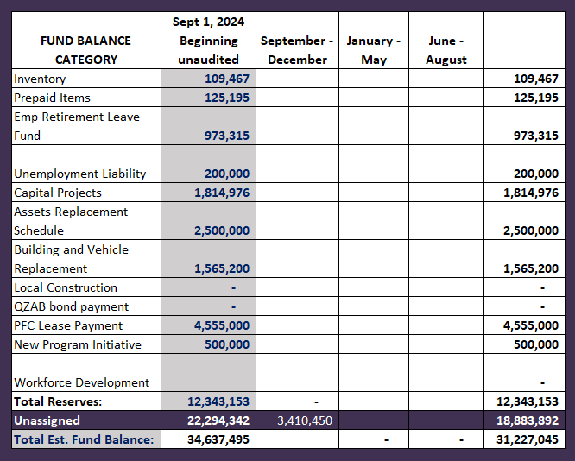
FY 2024-2025
Fund Balance
-
Budgeted Activity
Previous BAs
Leadership Academy in Crosby $ 350,000
Prairie view Grant match $ 41,000
Facilities $ 230,000
Tax $ 1,000,000
New NPO HVAC System $1,789,450

Slide 16
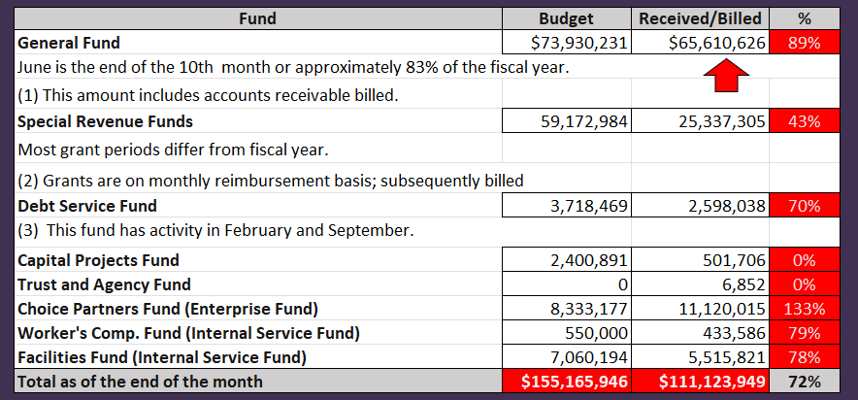
INTERIM FINANCIAL REPORT (unaudited)
GENERAL, SPECIAL REVENUE, DEBT SERVICE FUNDS, CAPITAL PROJECTS,
AND INTERNAL SERVICE FUNDS
REVENUES (INFLOWS)
Budget to Actual for period ending June 30, 2025

Slide 17
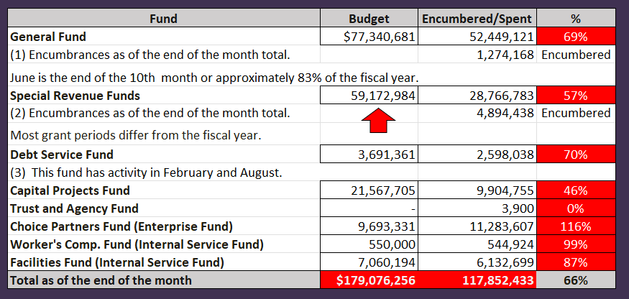
INTERIM FINANCIAL REPORT (unaudited)
GENERAL, SPECIAL REVENUE, DEBT SERVICE FUNDS, CAPITAL PROJECTS,
AND INTERNAL SERVICE FUNDS
Expenditures (OUTFLOWS)
Budget to Actual for period ending June 30, 2025

Slide 18
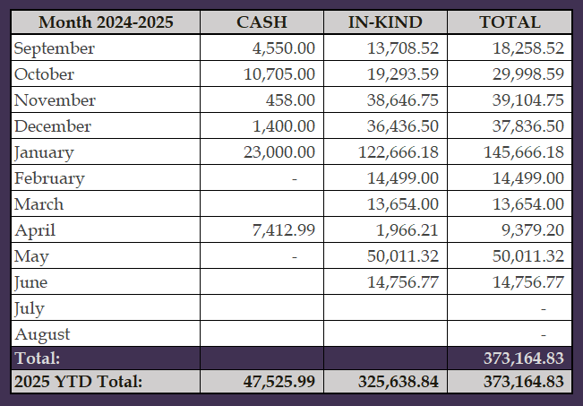
INTERIM FINANCIAL REPORT (unaudited)
FY 2024-25 Donations Report
All Funds as of June 30, 2025

Slide 19
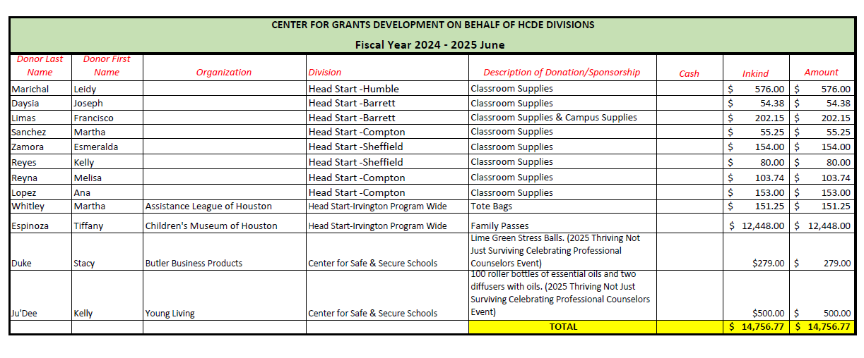
INTERIM FINANCIAL REPORT (unaudited)
FY 2024-25 Donations Report
All Funds as of June 30, 2025

Slide 20
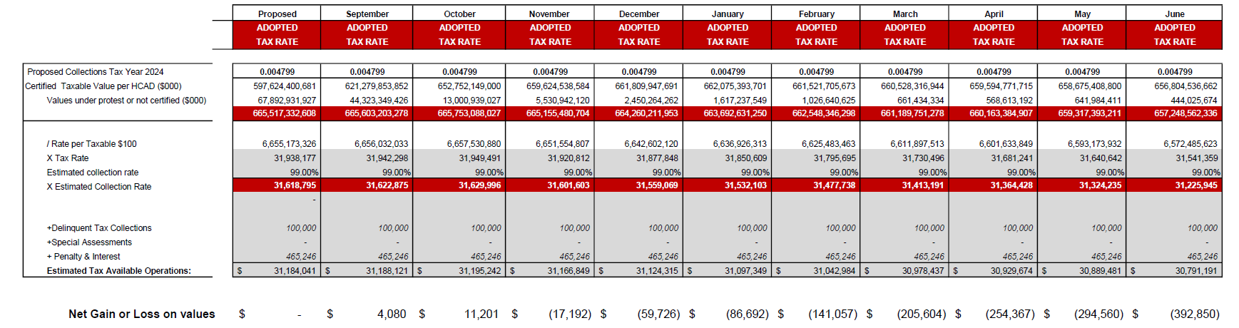
INTERIM FINANCIAL REPORT (unaudited)
TAX COLLECTIONS COMPARATIVE ANALYSIS
Fiscal Year-To-Date as of June 30, 2025
$656 B
See Tax Calculator at:
https://hcde-texas.org/transparency/tax-rate/

Slide 21
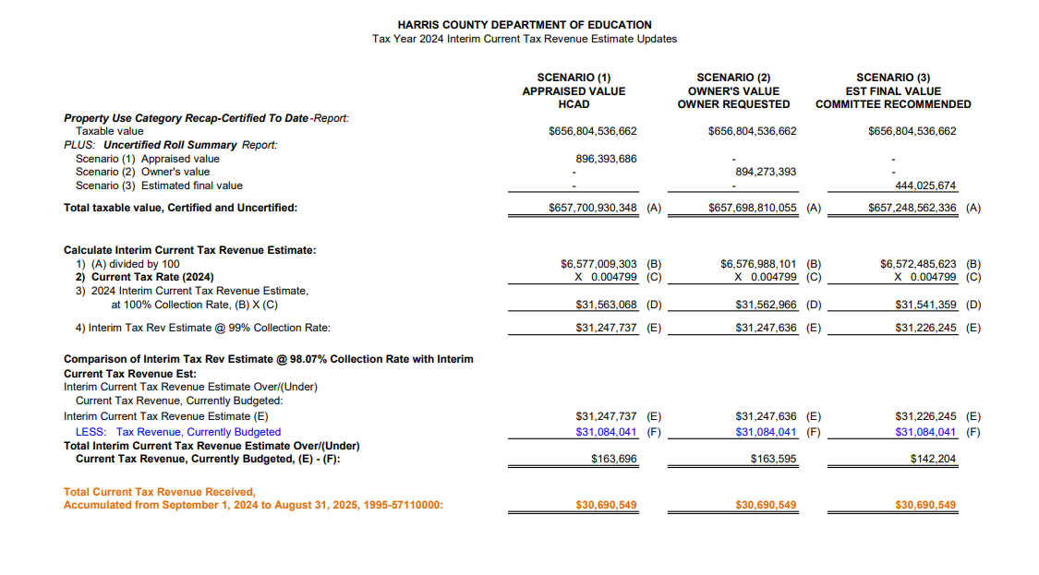
INTERIM FINANCIAL REPORT (unaudited) TAX COLLECTIONS
Fiscal Year-To-Date as of June 30, 2025
(10th month / 12 months)

Slide 22
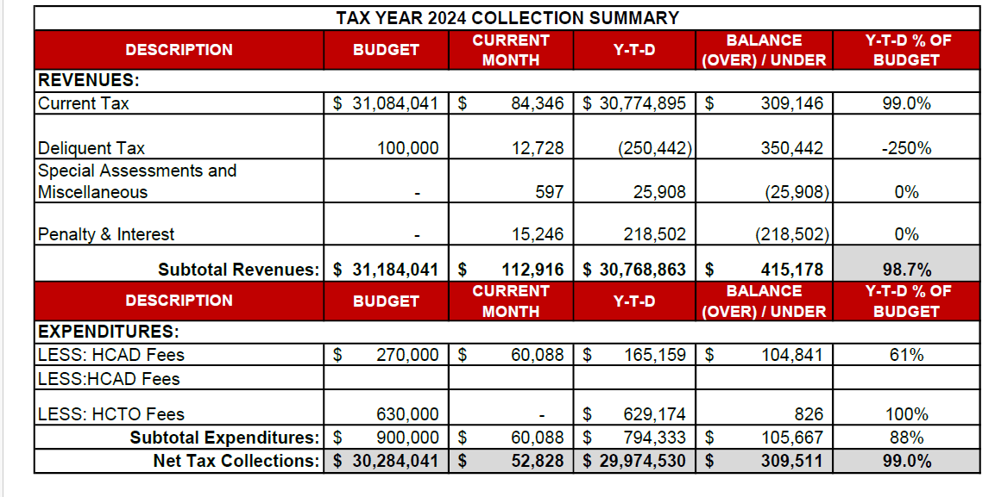
INTERIM FINANCIAL REPORT (unaudited) TAX COLLECTIONS
Fiscal Year-To-Date as of June 30, 2025
(10th month / 12 months)
a) 2024 Approved Tax Rate = $0.004799/$100 Property Assessment/Appraisal - --> Annual Tax on a $259,375 - $51,875 = $207,500/100
x .004799 = $9.958 (net of 20% homestead exception.)
b) $850,000/$32,184,041 = 2.64% Collection and assessment costs

Slide 23
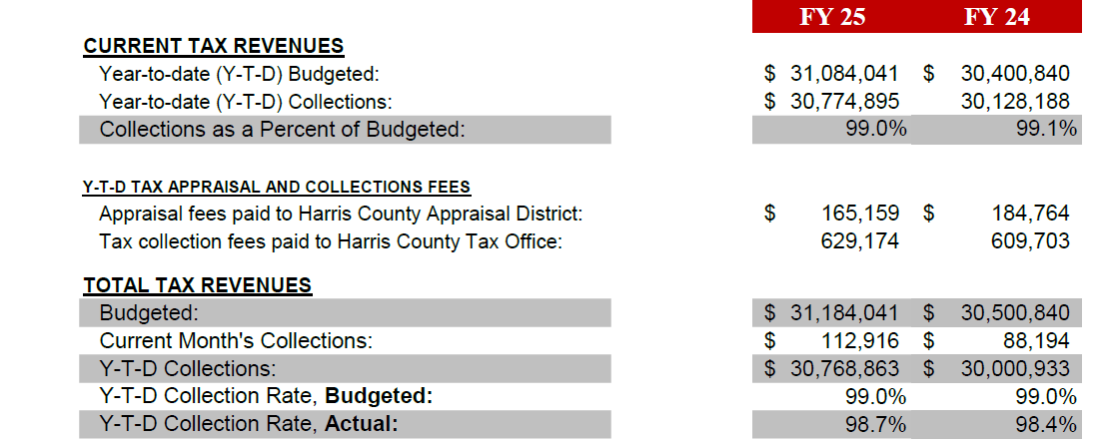
INTERIM FINANCIAL REPORT (unaudited) TAX COLLECTIONS
Fiscal Year-To-Date as of June 30, 2025
(10th month / 12 months)
a) 2024 Approved Tax Rate = $0.004799/$100 Property Assessment/Appraisal - --> Annual Tax on a $259,375 - $51,875 = $207,500/100
x .004799 = $9.958 (net of 20% homestead exception.)
b) $850,000/$32,184,041 = 2.64% Collection and assessment costs

Slide 24
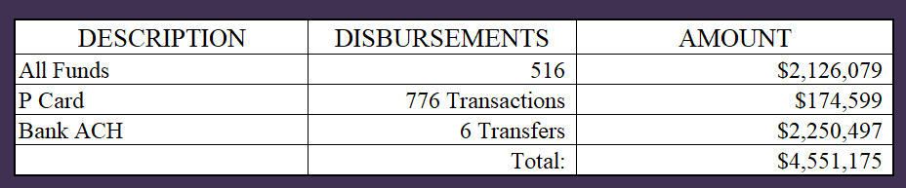
INTERIM FINANCIAL REPORT (unaudited)
DISBURSEMENT – ALL FUNDS
June 30, 2025
Notes:
All Purchase Orders and Payment Authorizations are reviewed before disbursement.
All Procurement Card charges are reviewed by cardholder, supervisor, and business office staff each month.
A report on CH Local Expenditures is included in the monthly report.

Slide 25
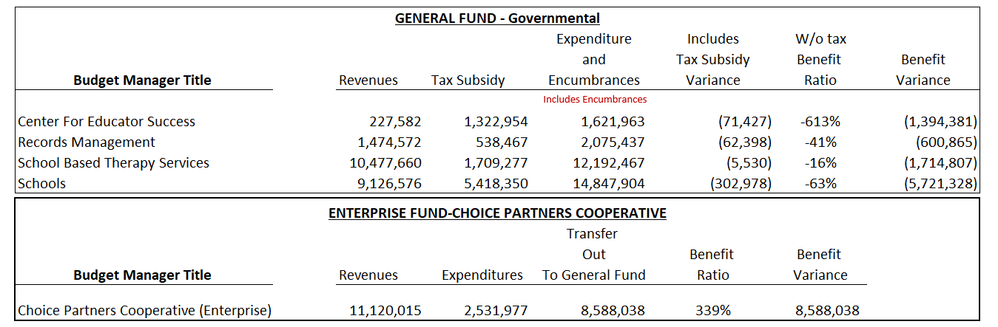
INTERIM FINANCIAL REPORT (unaudited)
Segment Division Data
As of June 30, 2025

Slide 26
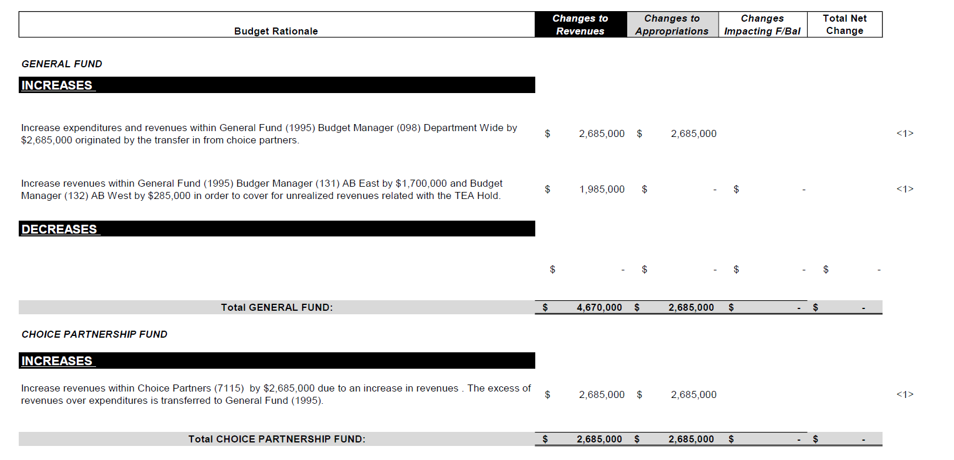
HIGHLIGHTS OF BUDGET AMENDMENT REPORT
June18th, Board Meeting
(unaudited)

Slide 27

Education Foundation Update
June 30, 2025
27

Slide 28
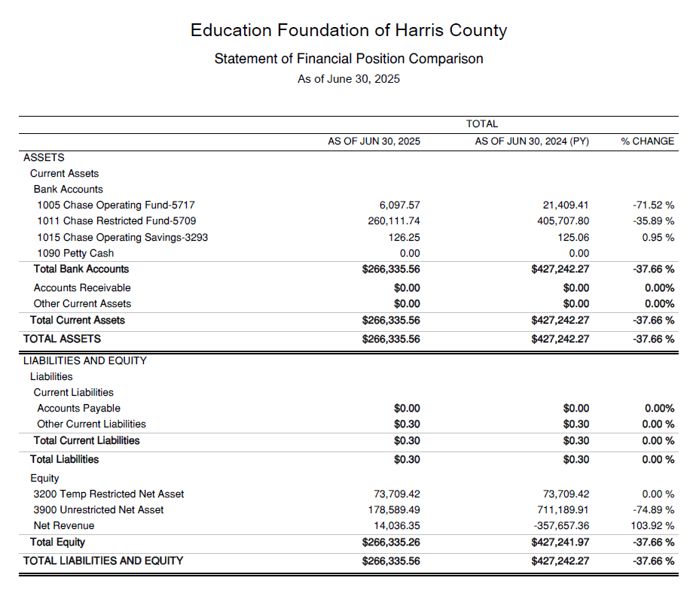
Statement of Financial Position
Net Equity
$266,335

Slide 29
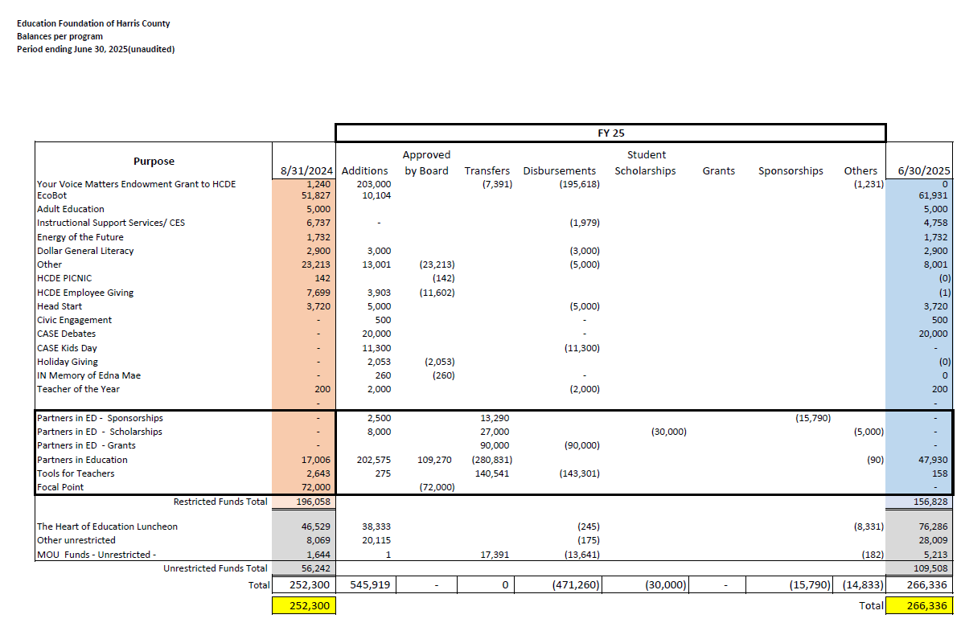
Ed Foundation Balances Per Program

Slide 30
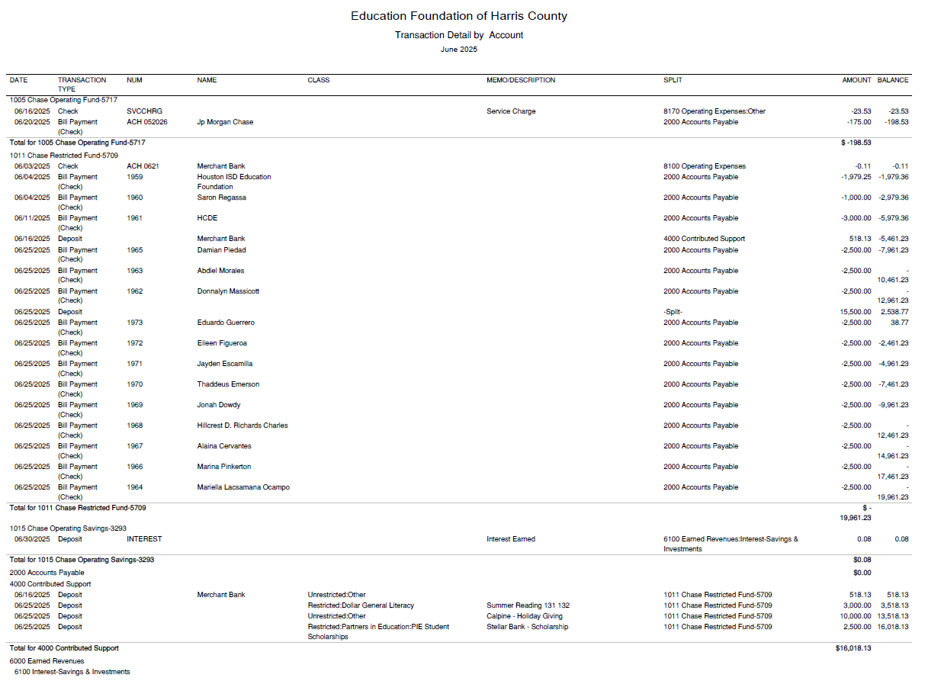
Transaction Detail by Inflow & Outflow

Slide 31
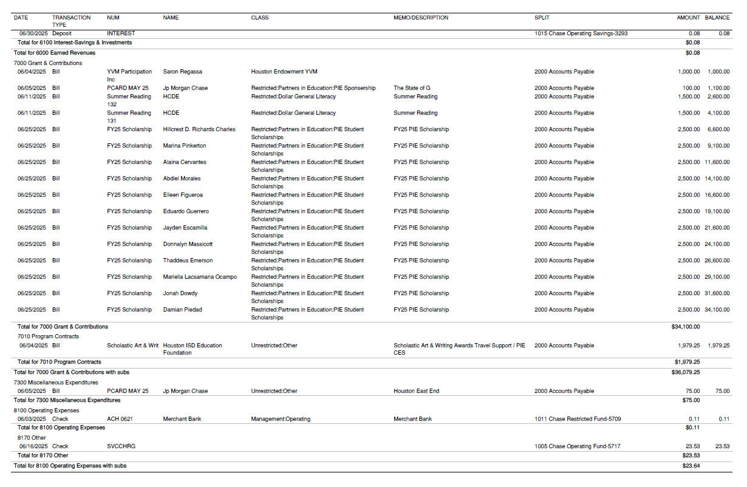
Transaction Detail by Inflow & Outflow

Slide 32

PFC & Lease Revenue Projects Update
June 30, 2025
32

Slide 33
Small Business Report FY2024-25
09/01/24 to 06/30/25
Submitted by:
Dr. Edna E. Johnson,
Procurement Services Director

Slide 34
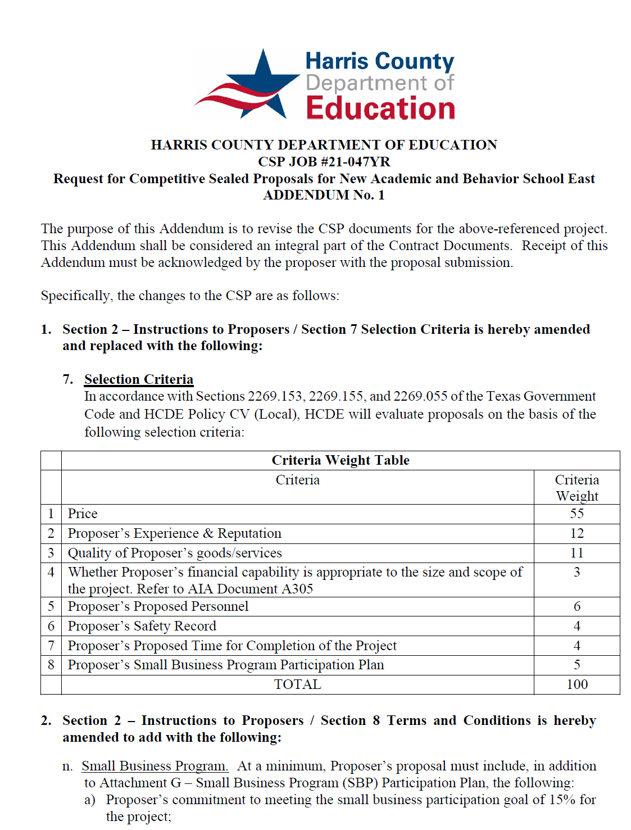
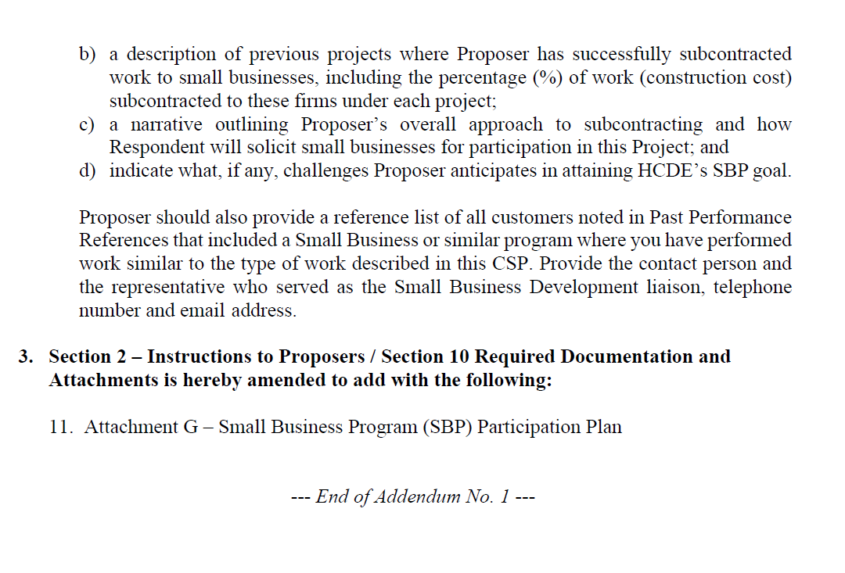
Small Business
for Construction
Launch industry's first collaboration feature
This is our plan as we launch the industry's first collaboration feature

Slide 35
Content
Small Business Expenditures for FY2024-25 Year to Date (09/01/24 to 06/30/25)
Graphic
List of Small Businesses

Slide 36
Expenditures FY 2024-25 (09/01/24 to 06/30/25)
Small Business $2,519,912
Non-Small Business $16,640,624
Total Business = $19,160,536
Govt and Utilities $3,896,907
Total Expenditures = $23,057,443
Small Business $2,519.912
divided by
Total Business $19,160,536
13% Ratio Small/Large

Slide 37
List of Small Businesses FY 2024-25
37
Vendor | Sum of Payments | Business Capabilities
APPDDICTION STUDIO LLC | $ 10,382 | Computer Programming Services, Network systems integration design services, computer, Other Computer Related Services
ARCHIE D CRAFT | $ 18,480 | Golf instruction, Camps or Schools
BLUE KNIGHT SECURITY LLC | $ 308,363 | Security guards and patrol services
BRAINBUZZED TUTORING INC | $ 45,563 | Exam Preparation and Tutoring
BUTLER BUSINESS PRODUCTS | $ 228,752 | Office Supplies and Stationery Stores
CRE8 INCORPORATED | $ 132,270 | Architecture and LEED Design Services
DURA PIER FACILITIES SERVICES LTD | $ 65,271 | Building and Construction and Maintenance Services
EMA SPORT SOLUTIONS LLC | $ 493,617 | Sport Facilities Construction, Flooring and Turf Installation, Fence Installation, Demolition
ENGLISH + ASSOCIATES ARCHITECTS INC | $ 137,170 | Architectural And Interior Design: Architectural Services
FRENCH CORNER CATERING INC | $ 11,983 | Concessions, Catering, Vending:
GENWEL INC | $ 47,285 | Before/After School Program and Art Education
HTS INC CONSULTANTS | $ 23,484 | Geotechnical Laboratory Service and Other Scientific & Technical Consulting Services
INFRASTRUCTURE ASSOCIATES INC | $ 113,185 | Engineering Services; Design Services
NASH INDUSTRIES INC | $ 69,145 | Construction Management, Residential Remodeling, Project Management
NETSYNC NETWORK SOLUTIONS | $ 18,144 | Data Communications Equipment (e.g., bridges, gateways, routers) Local Area Network (LAN) Communications Equipment Wide Area Network Communications Equipment
PS LIGHTWAVE INC | $ 25,576 | Electrical Contractors and Other Wiring Installation Contractors
QSS, L.C | $ 188,210 | Fire/Alarm Systems Installation
SHI GOVERNMENT SOLUTIONS INC | $ 126,321 | Custom Computer Programming Services; Computer Accessories And Supplies
VERSA CREATIVE GROUP LLC | $ 456,713 | Marketing Consulting Services
 | $ 2,519,912 | Small Business as of 06/30/2025

Slide 38
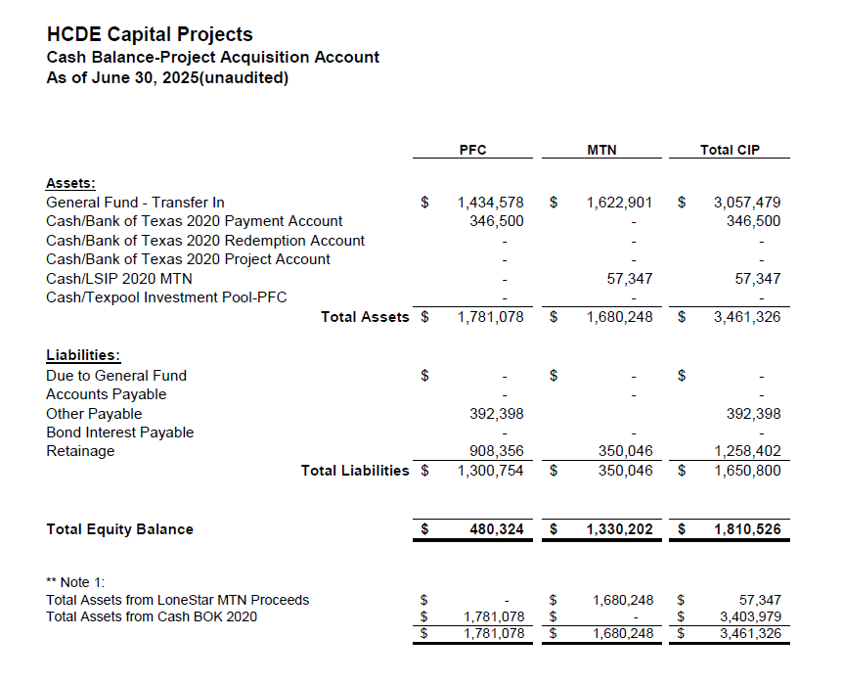

AB East School Contract $12,358,000 Awarded
Adult Ed Center Contract $15,121,000 Awarded on Oct 2021 Board Mtg
HP East Contract $7,271,000 Awarded on Nov 2021
Irvington – $11,172,589 Awarded on Jan 2024
Cash Balance –
Project Acquisition Account
As of June 30, 2025
38

Slide 39
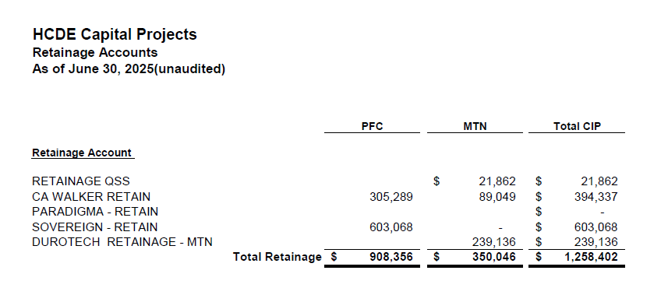
2020 MTN NOTES/2020 PFC BONDS
Pending Retainage Payable
Retainage Payable
Project Acquisition Account
As of June 30, 2025
39

Slide 40
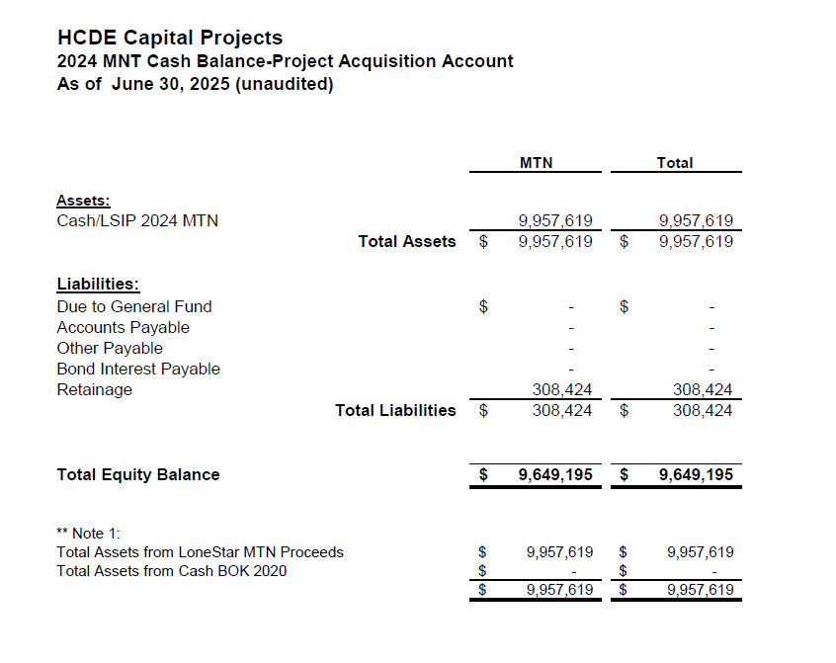
AB West $333,000 March 2024 Board Mtg
HS Barrett Station $470,000 March 2024 Board Mtg
Fortis Academy $650,000 March 2024 Board Mtg
Irvington – $9,860,000 March 2024 Board Mtg
Post Oak - $5,000,000 March 2024 Board Mtg
$16,313,000
Cash Balance –
2024 Maintenance Notes
As of June 30, 2025
40

Slide 41
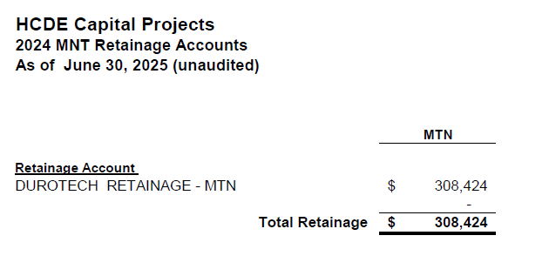
AB West $333,000 March 2024 Board Mtg
HS Barrett Station $470,000 March 2024 Board Mtg
Fortis Academy $650,000 March 2024 Board Mtg
Irvington – $9,860,000 March 2024 Board Mtg
Post Oak - $5,000,000 March 2024 Board Mtg
$16,313,000
Retainage Payable
2024 Maintenance Notes
As of June 30, 2025
41

Slide 42
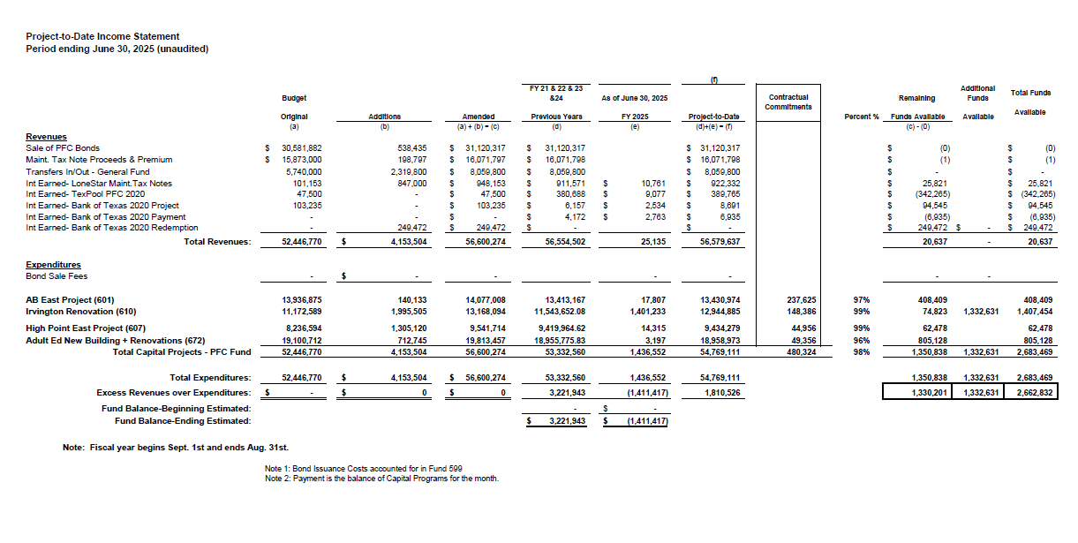
Income Statement– Project Acquisition Account
As of June 30, 2025
42

Slide 43
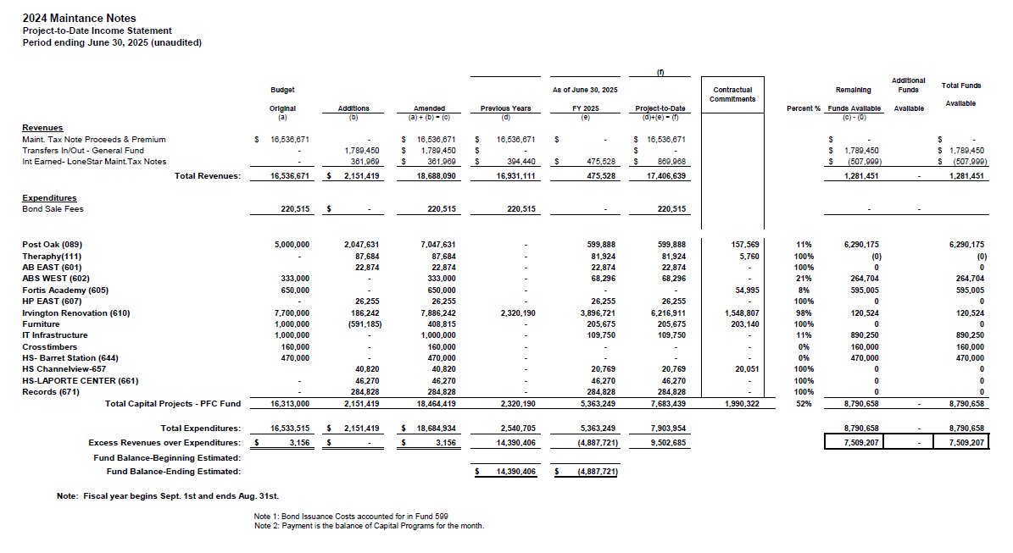
Income Statement– 2024 MNT NOTES
As of June 30, 2025
43

Slide 44
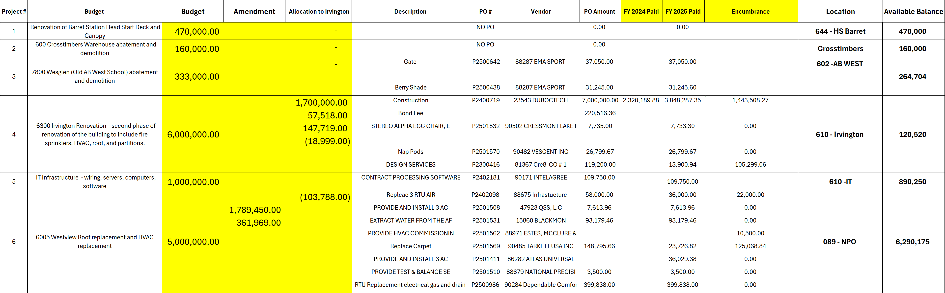
Maintenance Notes 2024 – Projects
44

Slide 45
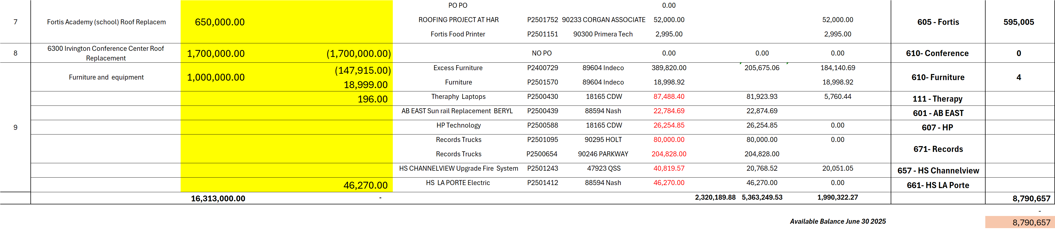
Maintenance Notes 2024 – Projects
45

Slide 46
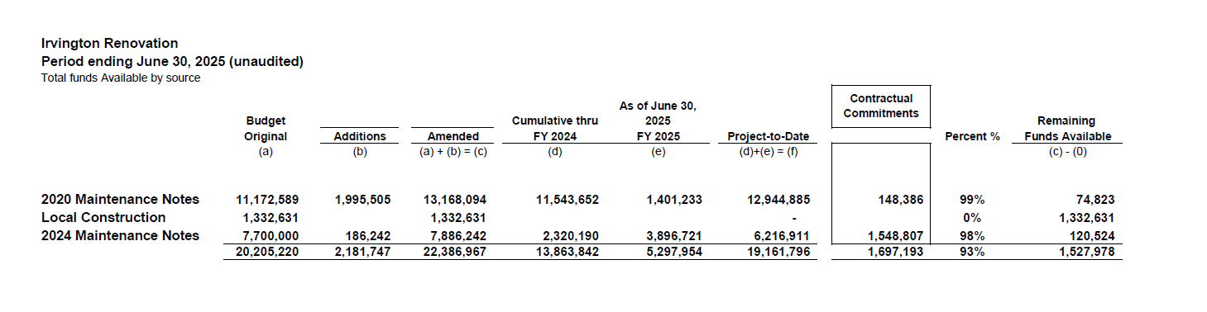
Irvington Renovation – Funds by Source
As of June 30, 2025
Irvington Renovation 2020 Maintenance Notes $ 4,781,519
Contract 2024 Maintenance Notes $ 7,000,000
Total $11,781,519
46

Slide 47

Interim Financial Report (unaudited)
I certify that the foregoing information is true and accurate to the best of my knowledge.
/s/ Jesus J. Amezcua, RTSBA,CPA, Ph.D., CPFIM, Asst. Supt. for Business Support Services
/s/ Marcia Leiva, Chief Accounting Officer

